Slide 1
South Dakota Airport Historic Photographs
April 6, 2022

Slide 2
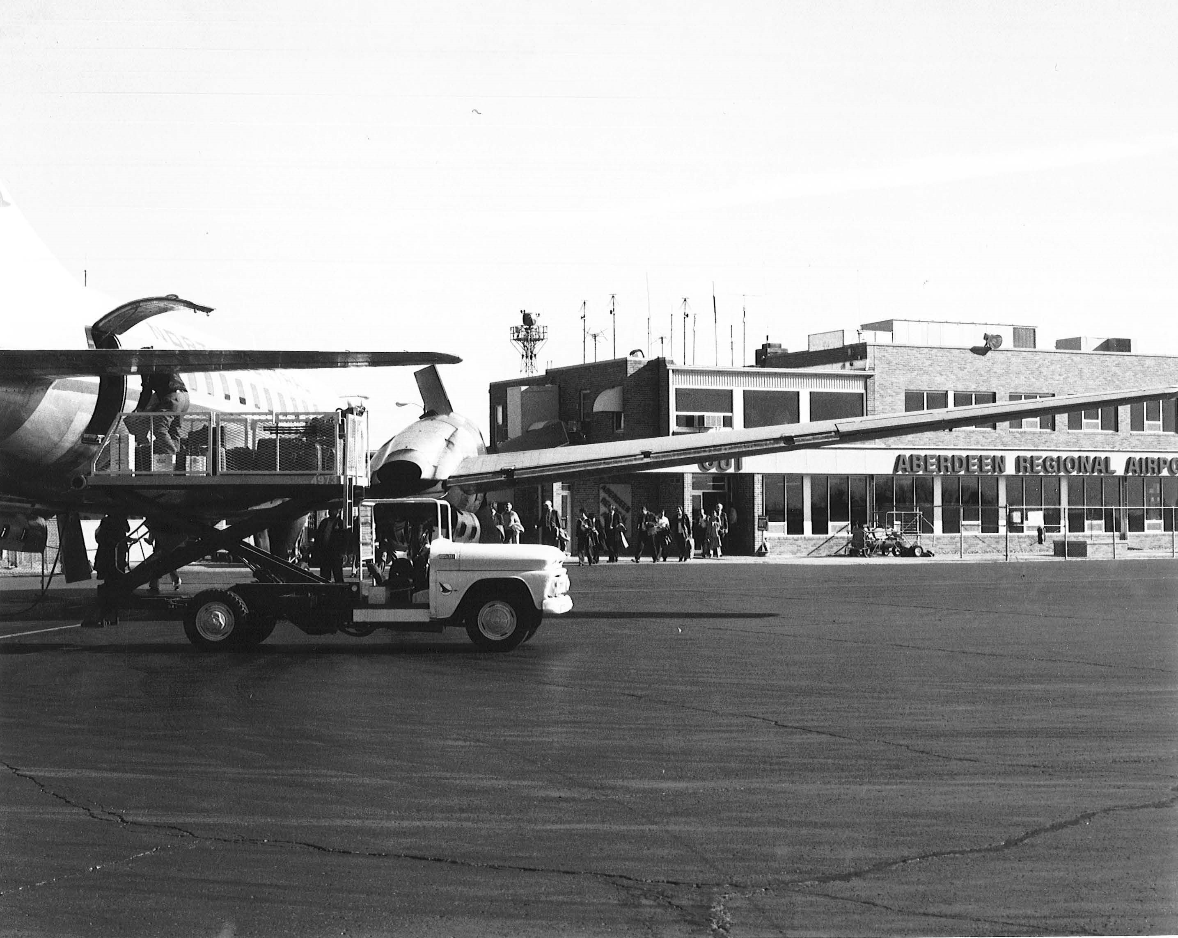
Aberdeen Conviar 580 on Apron

Slide 3
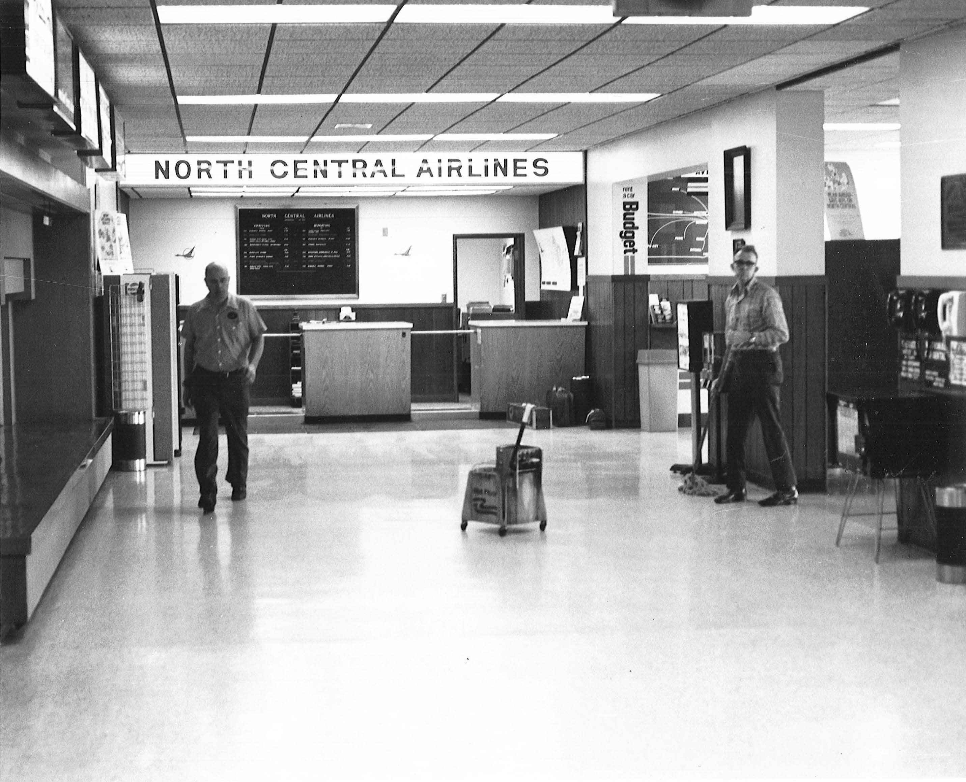
Aberdeen Terminal

Slide 4
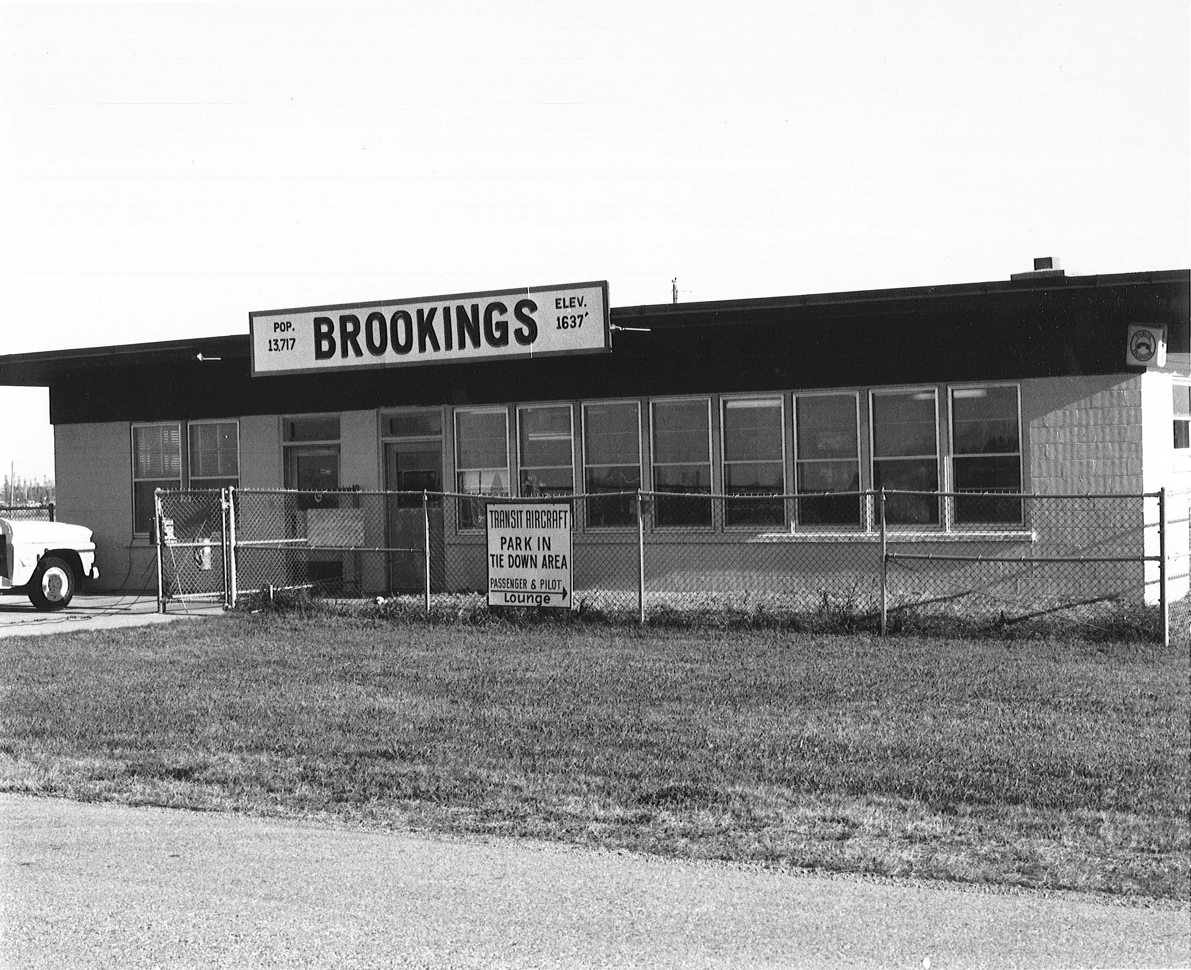
Brookings Terminal

Slide 5
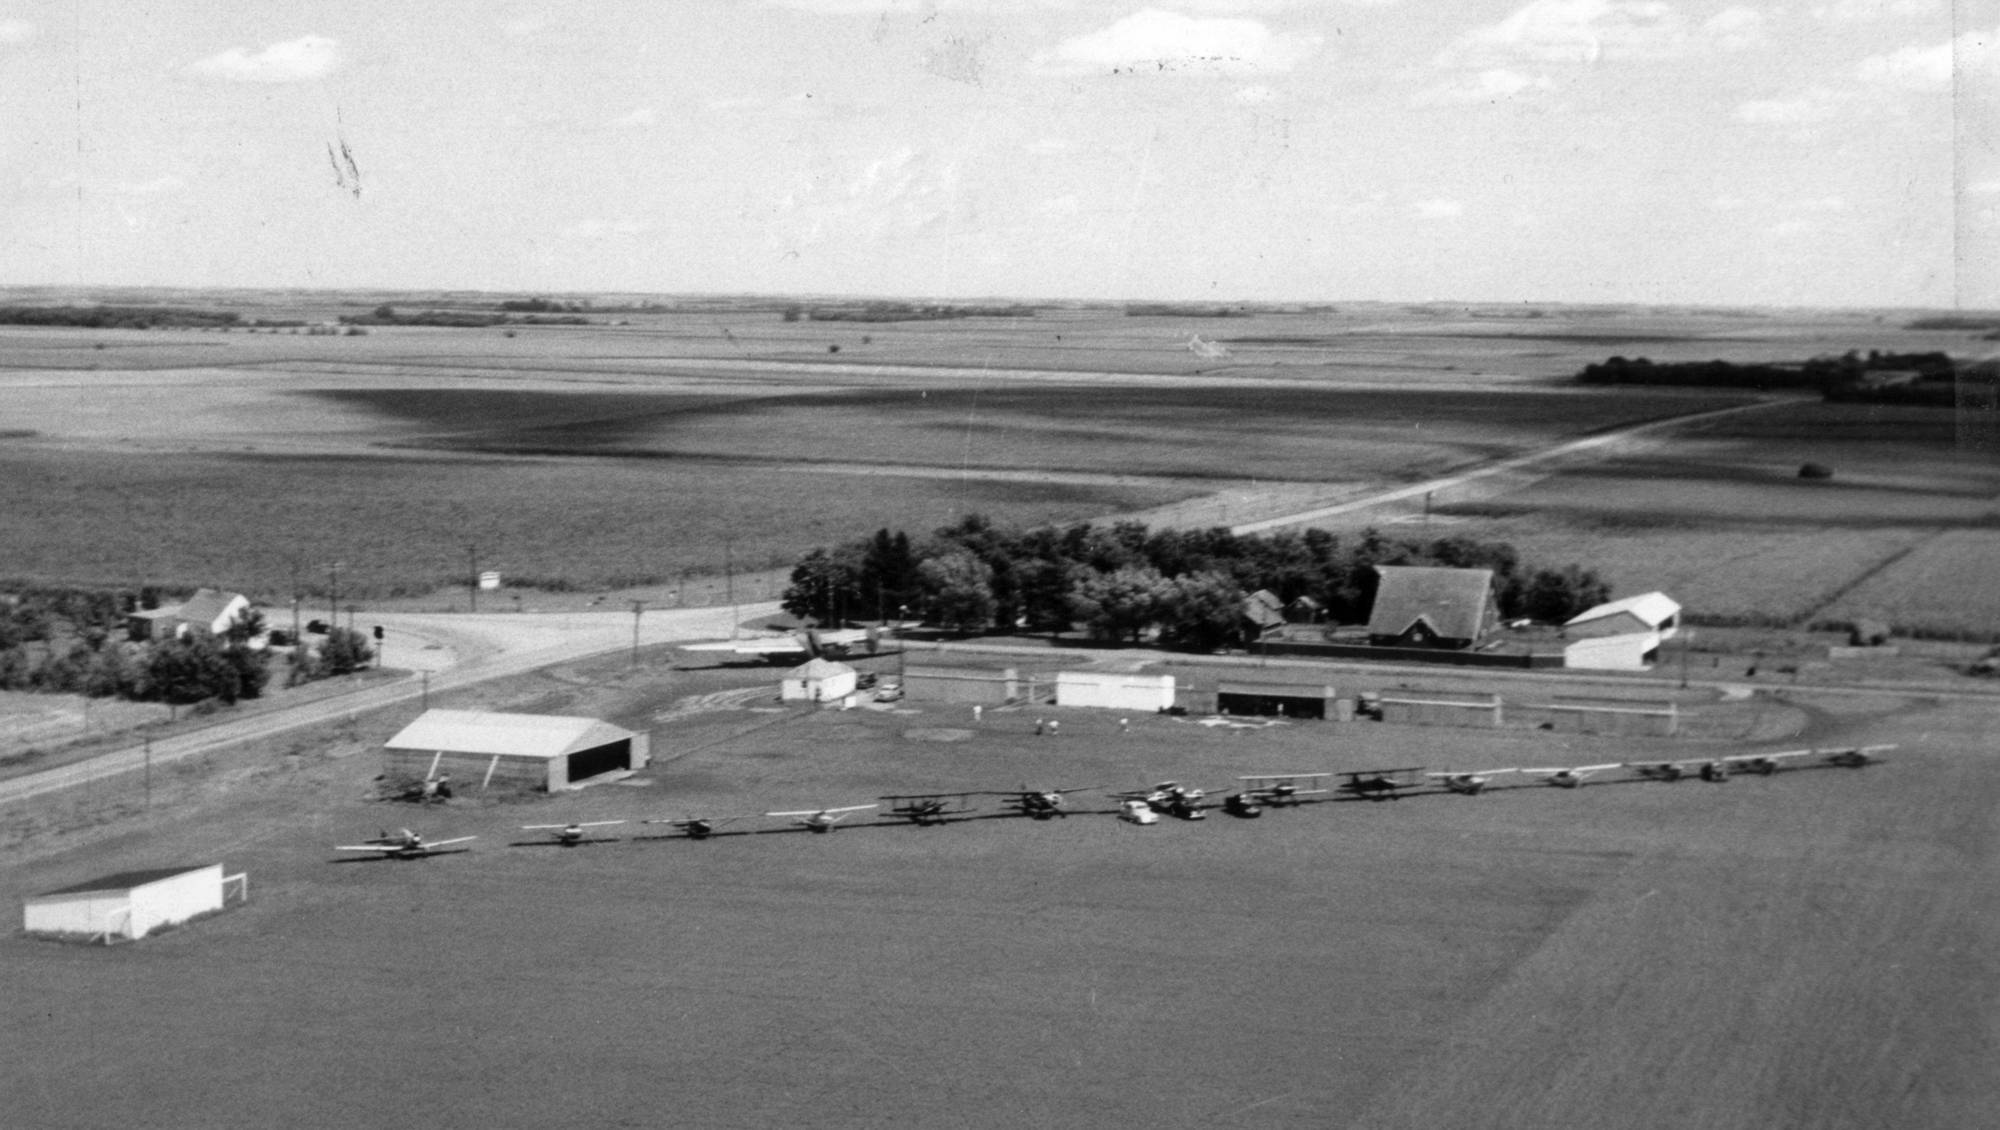
Flandreau

Slide 6
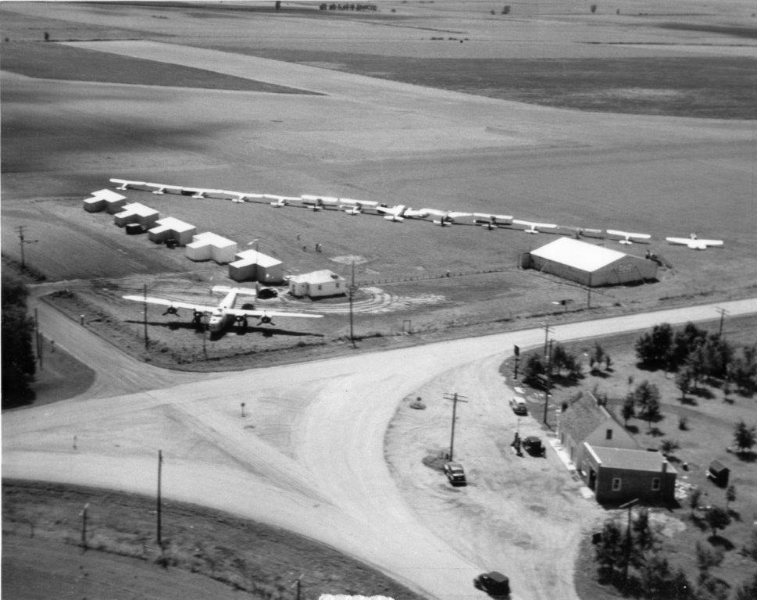

Slide 11
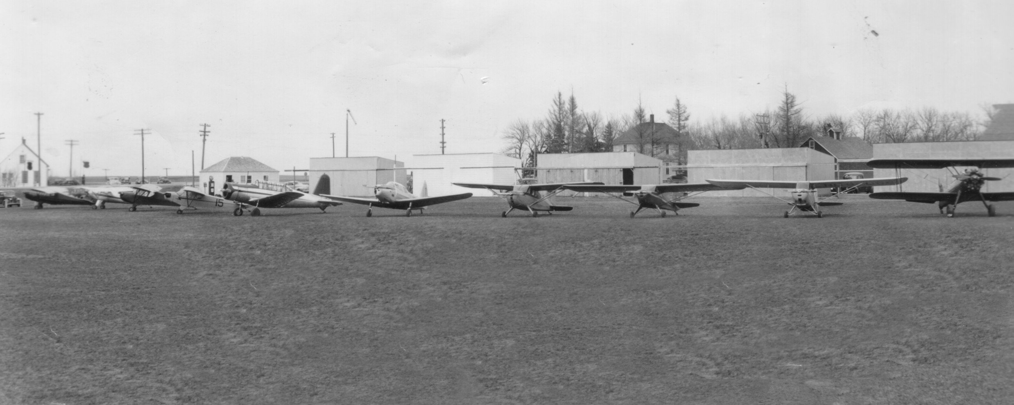

Slide 12
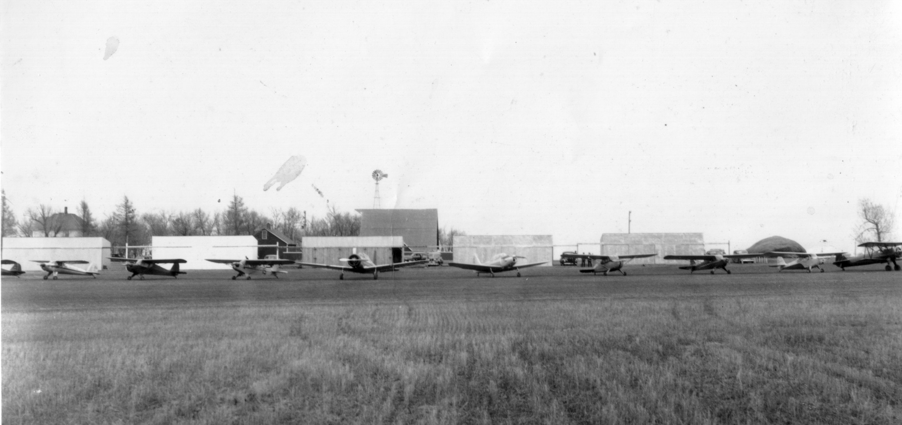

Slide 13
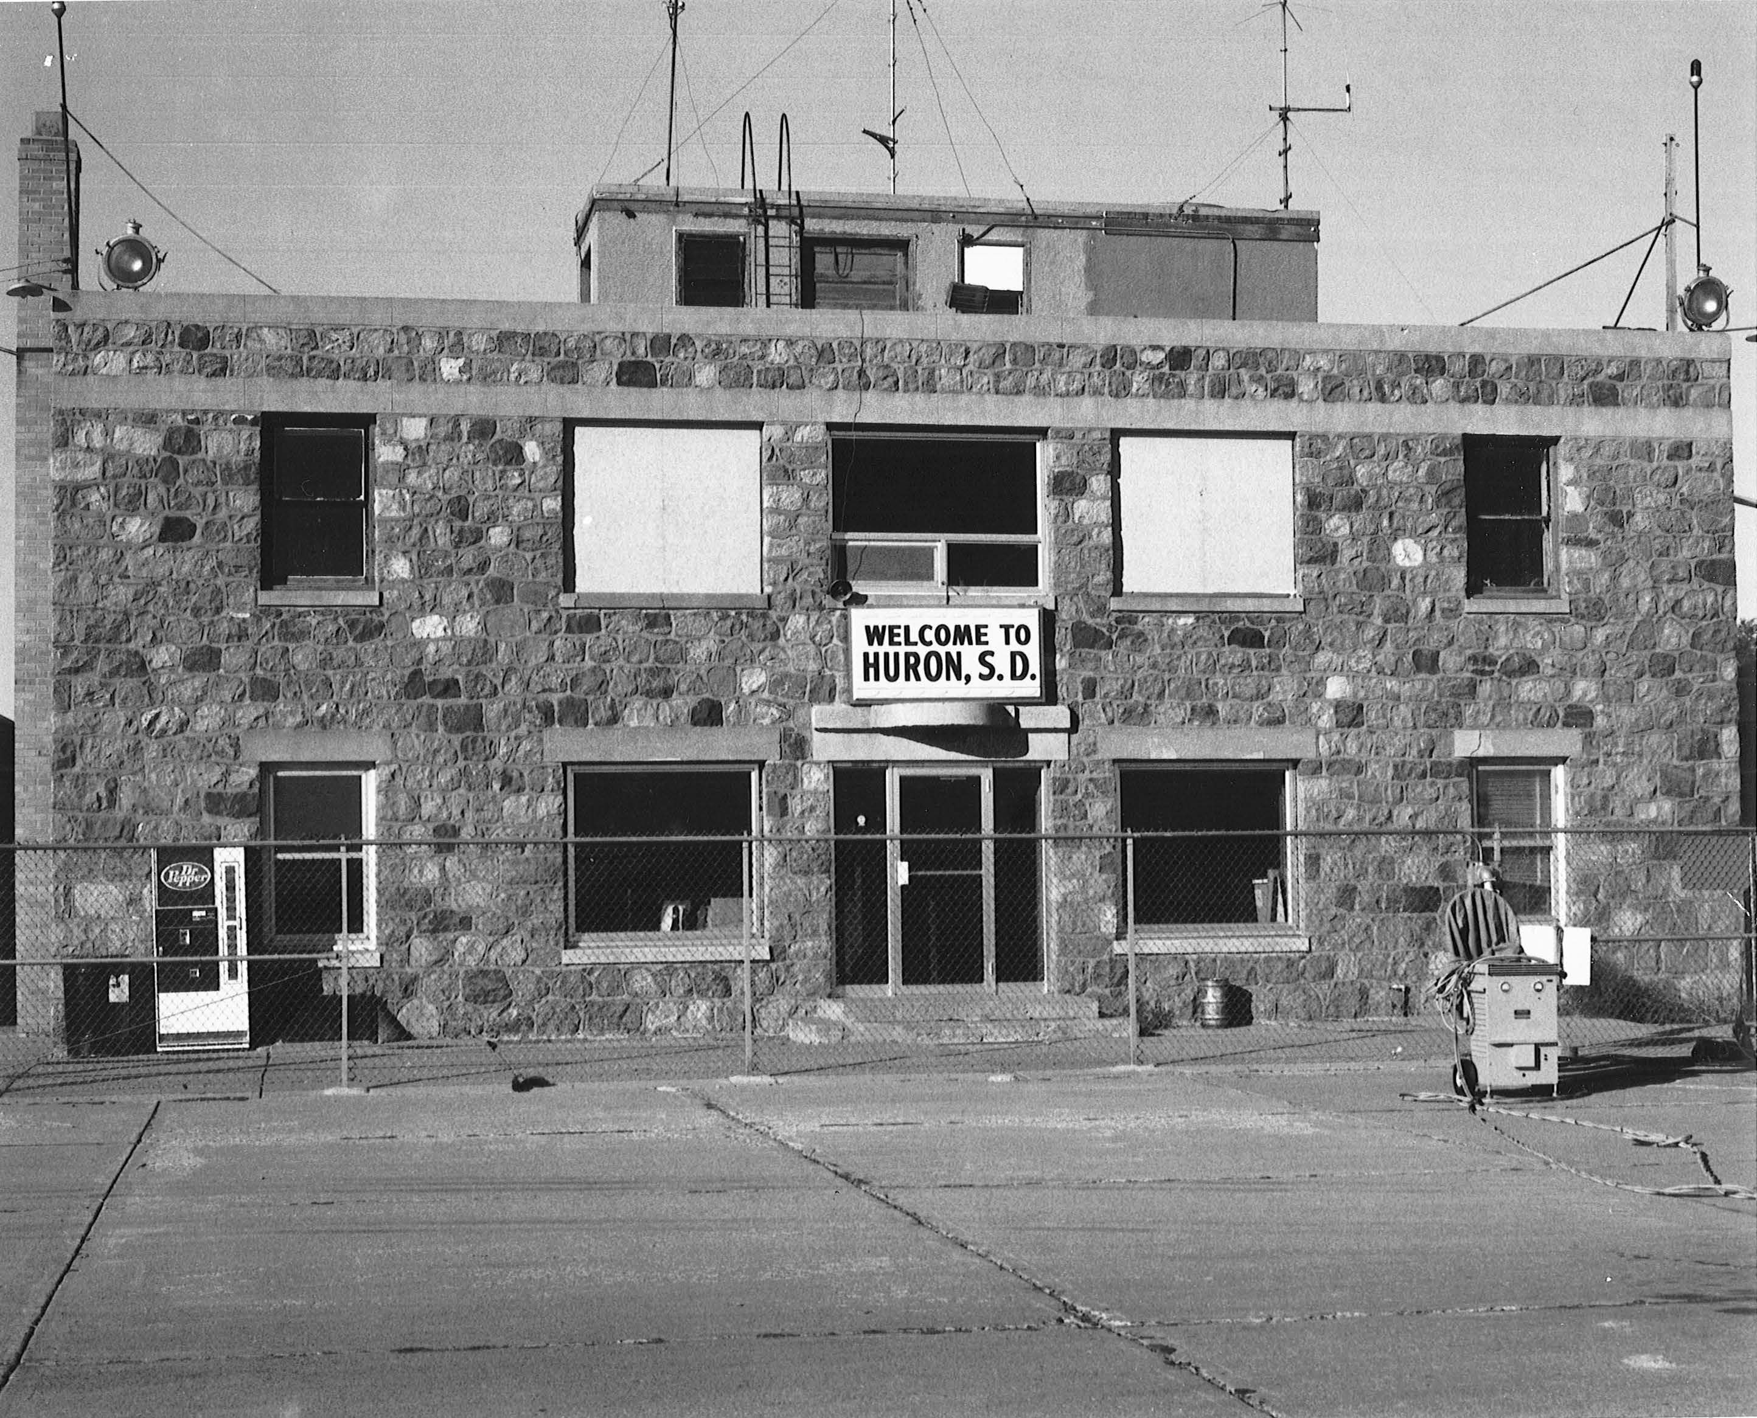

Slide 14
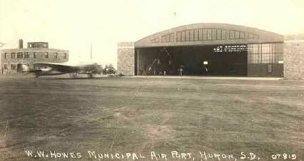
Howes Airport, Huron

Slide 15
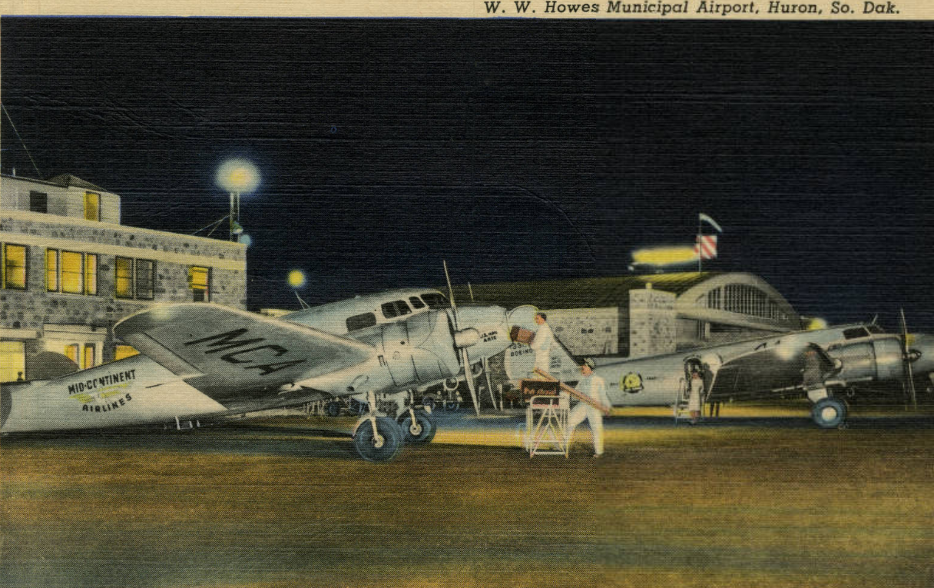

Slide 16
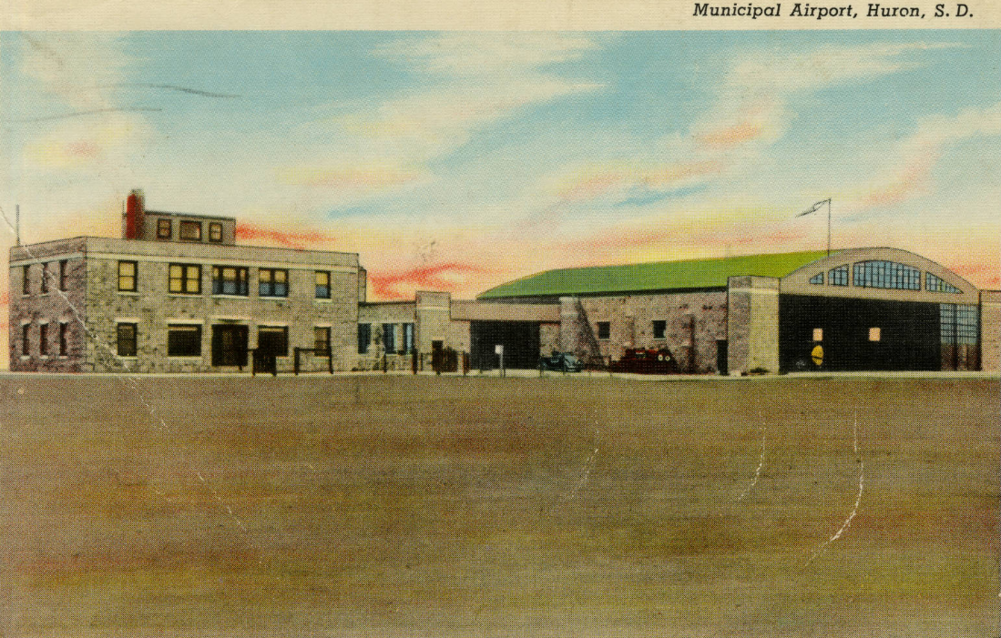

Slide 17
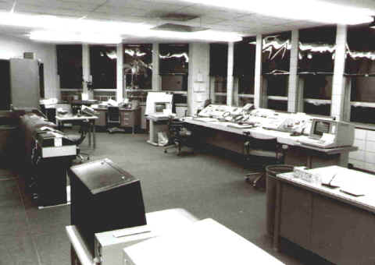
Huron Flight Service 1984

Slide 18
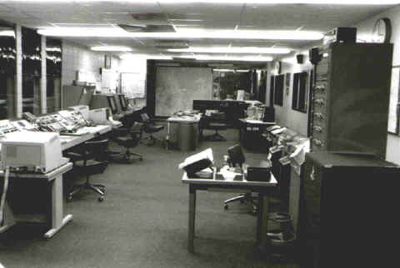

Slide 19
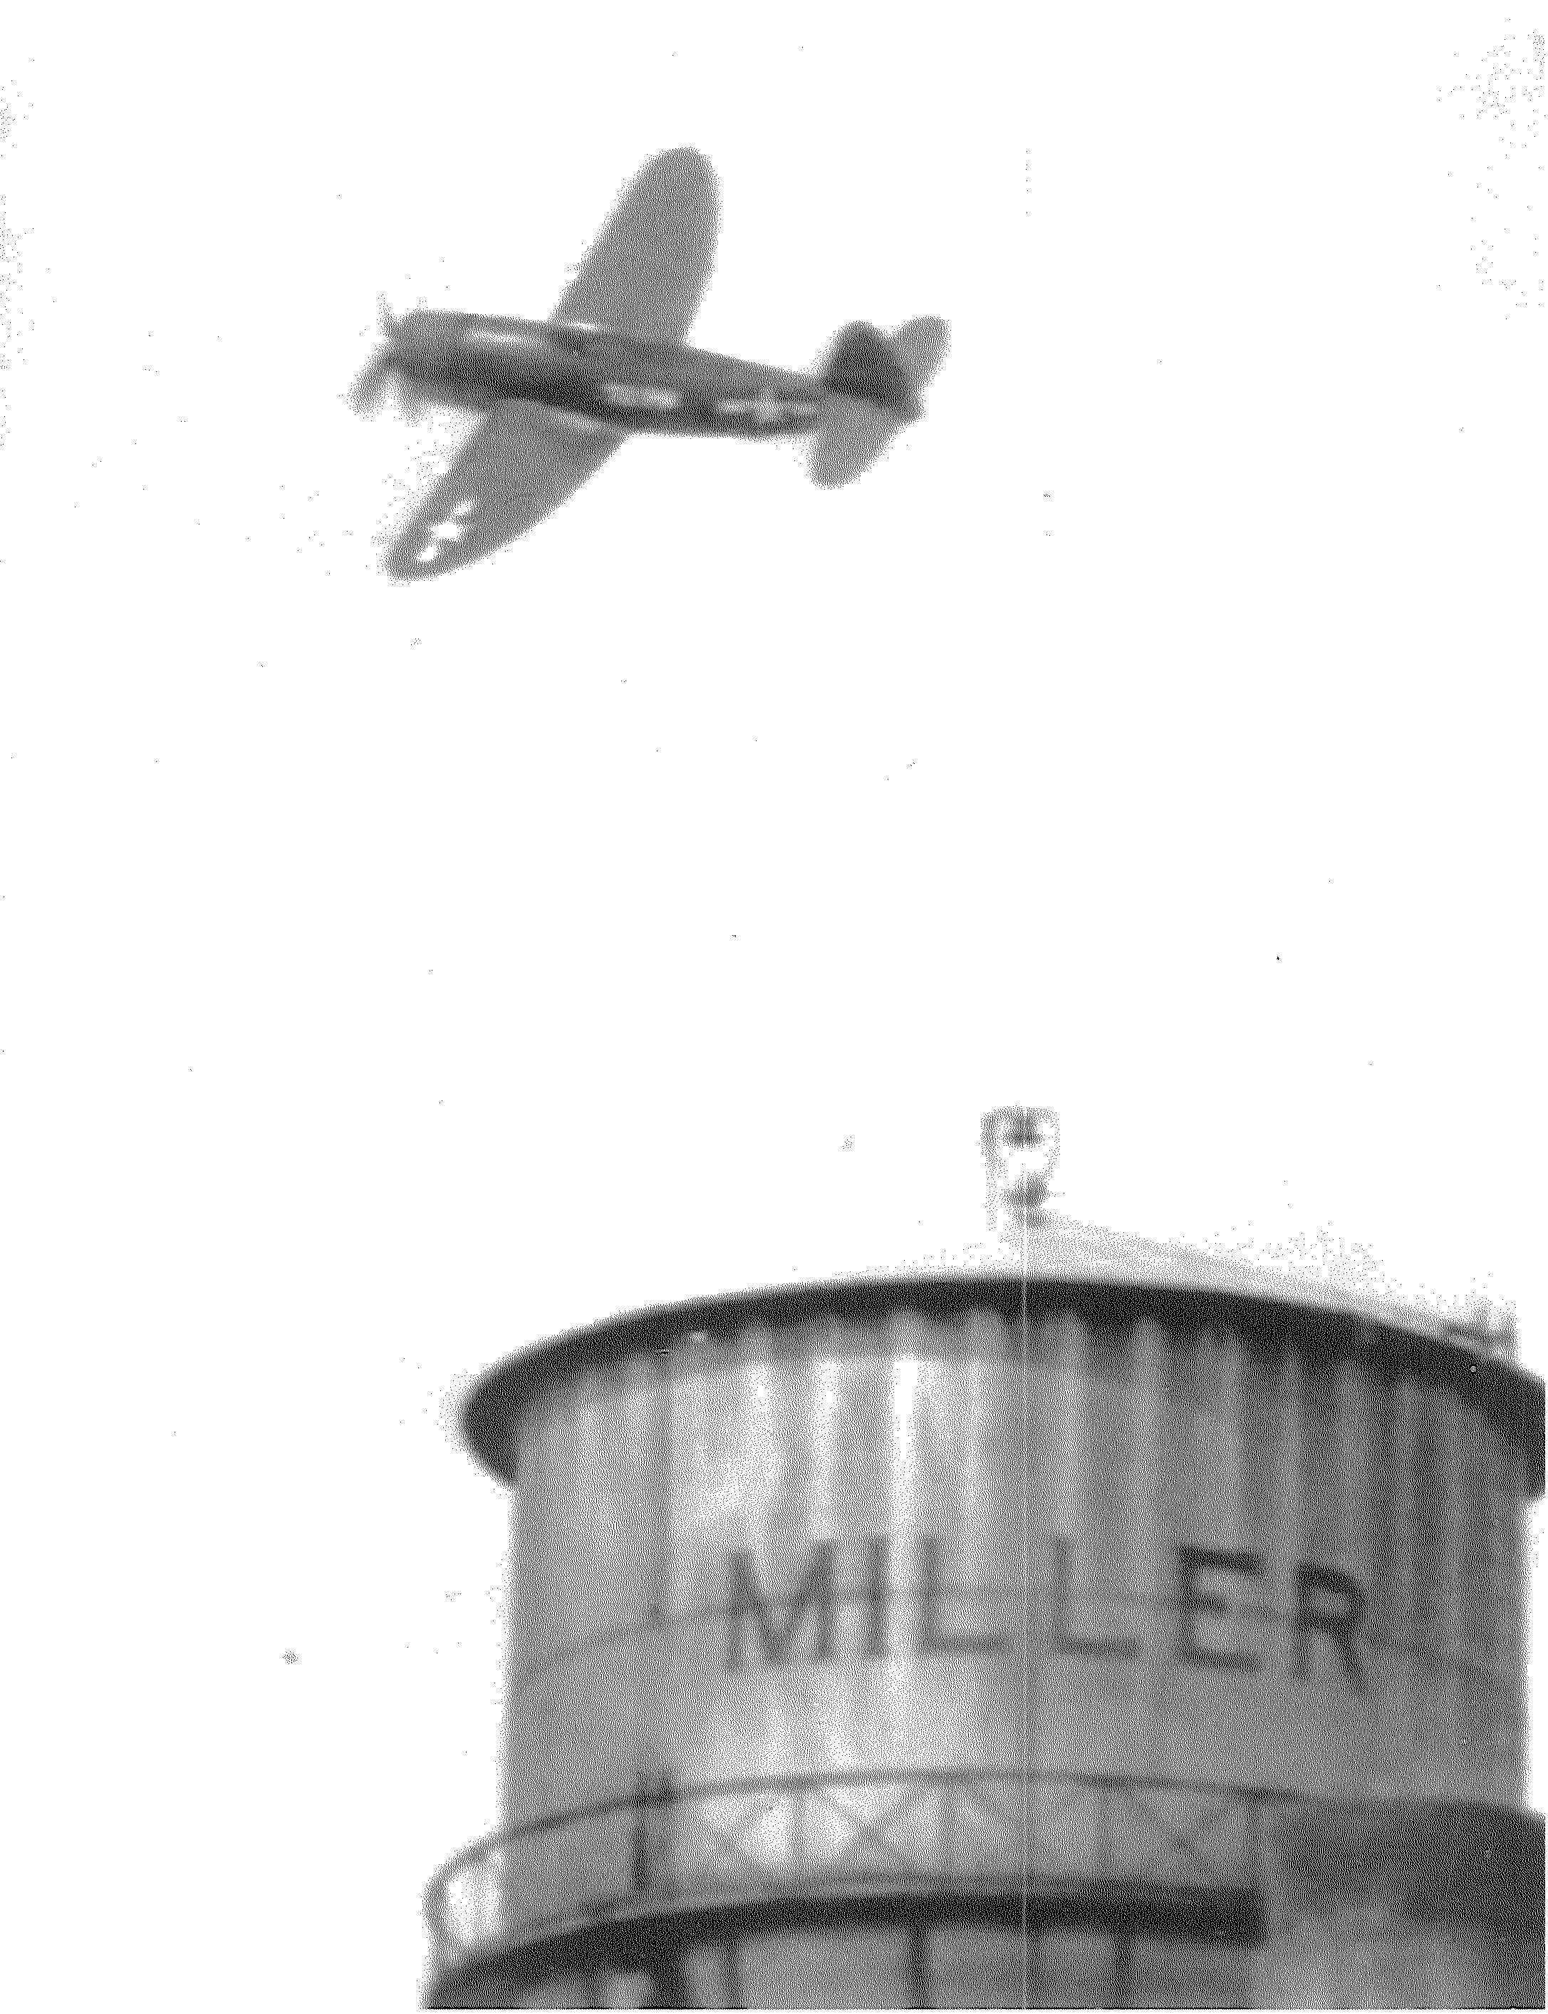
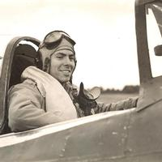
Miller – 1st Lt. Ben Barnes, US Army Air Corps, flies over the Miller Water Tower

Slide 20
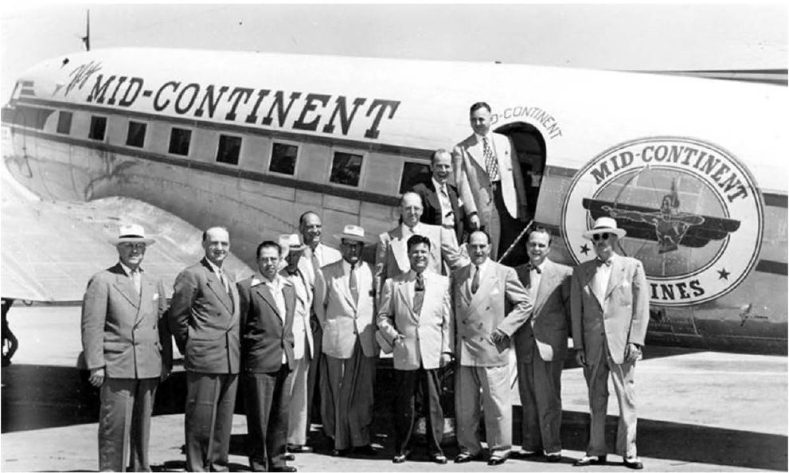
Midcontinent was the first twin-engine to fly into Mitchell

Slide 21
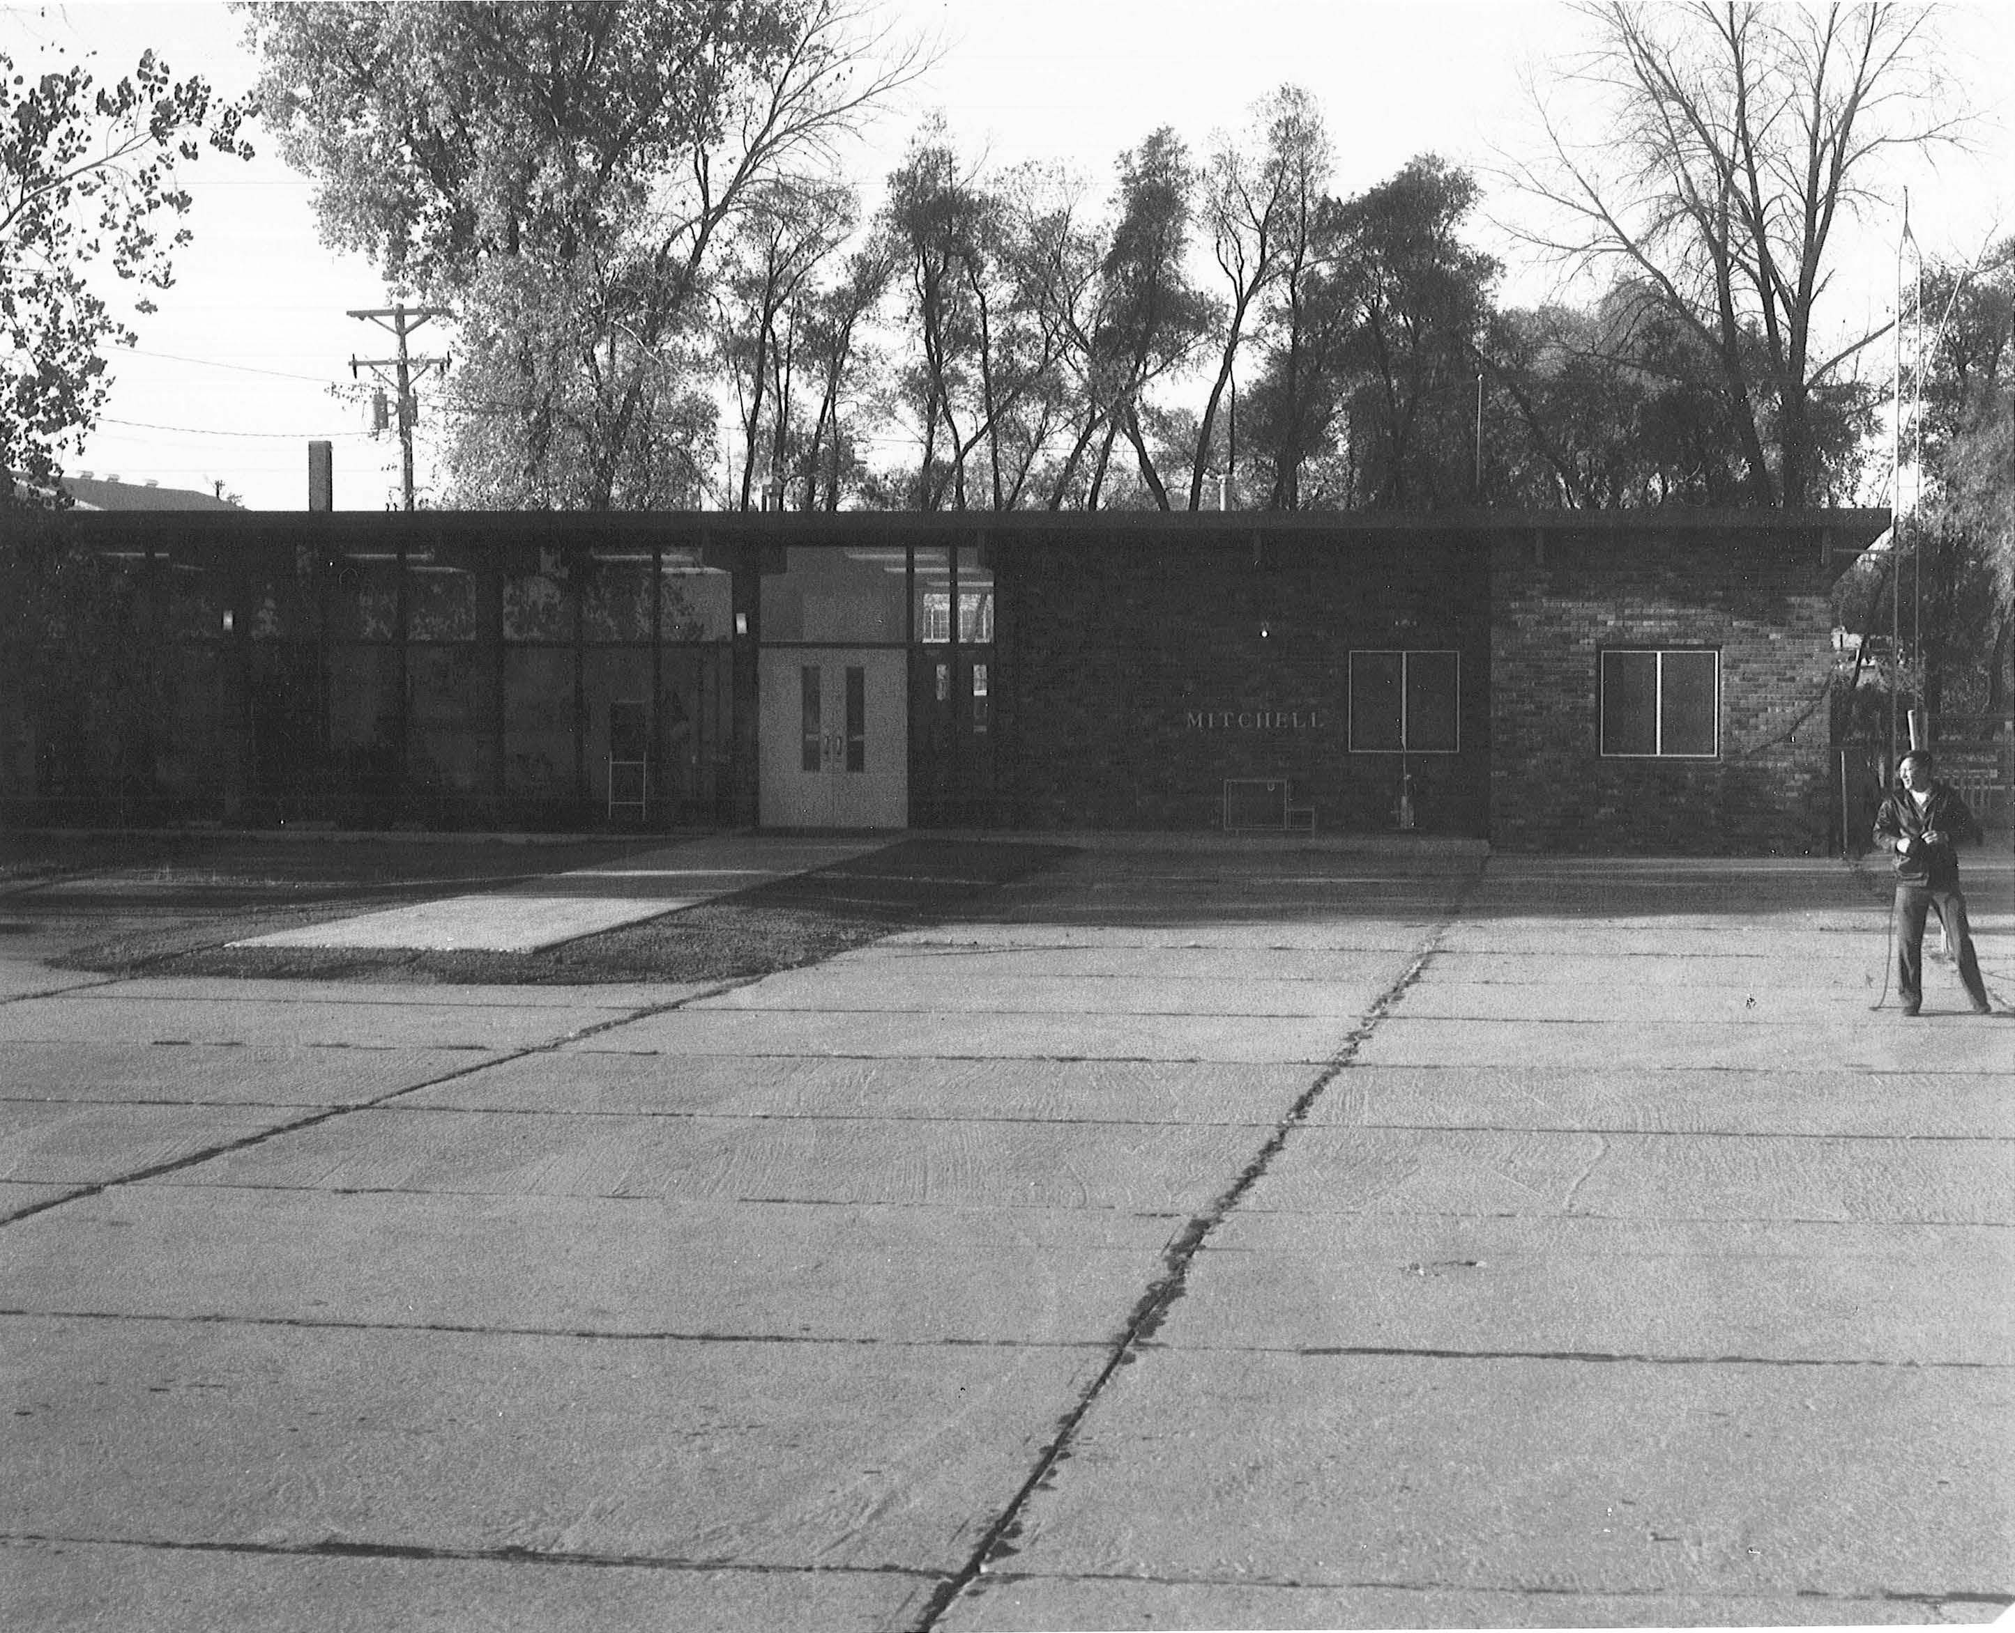
Mitchell

Slide 22
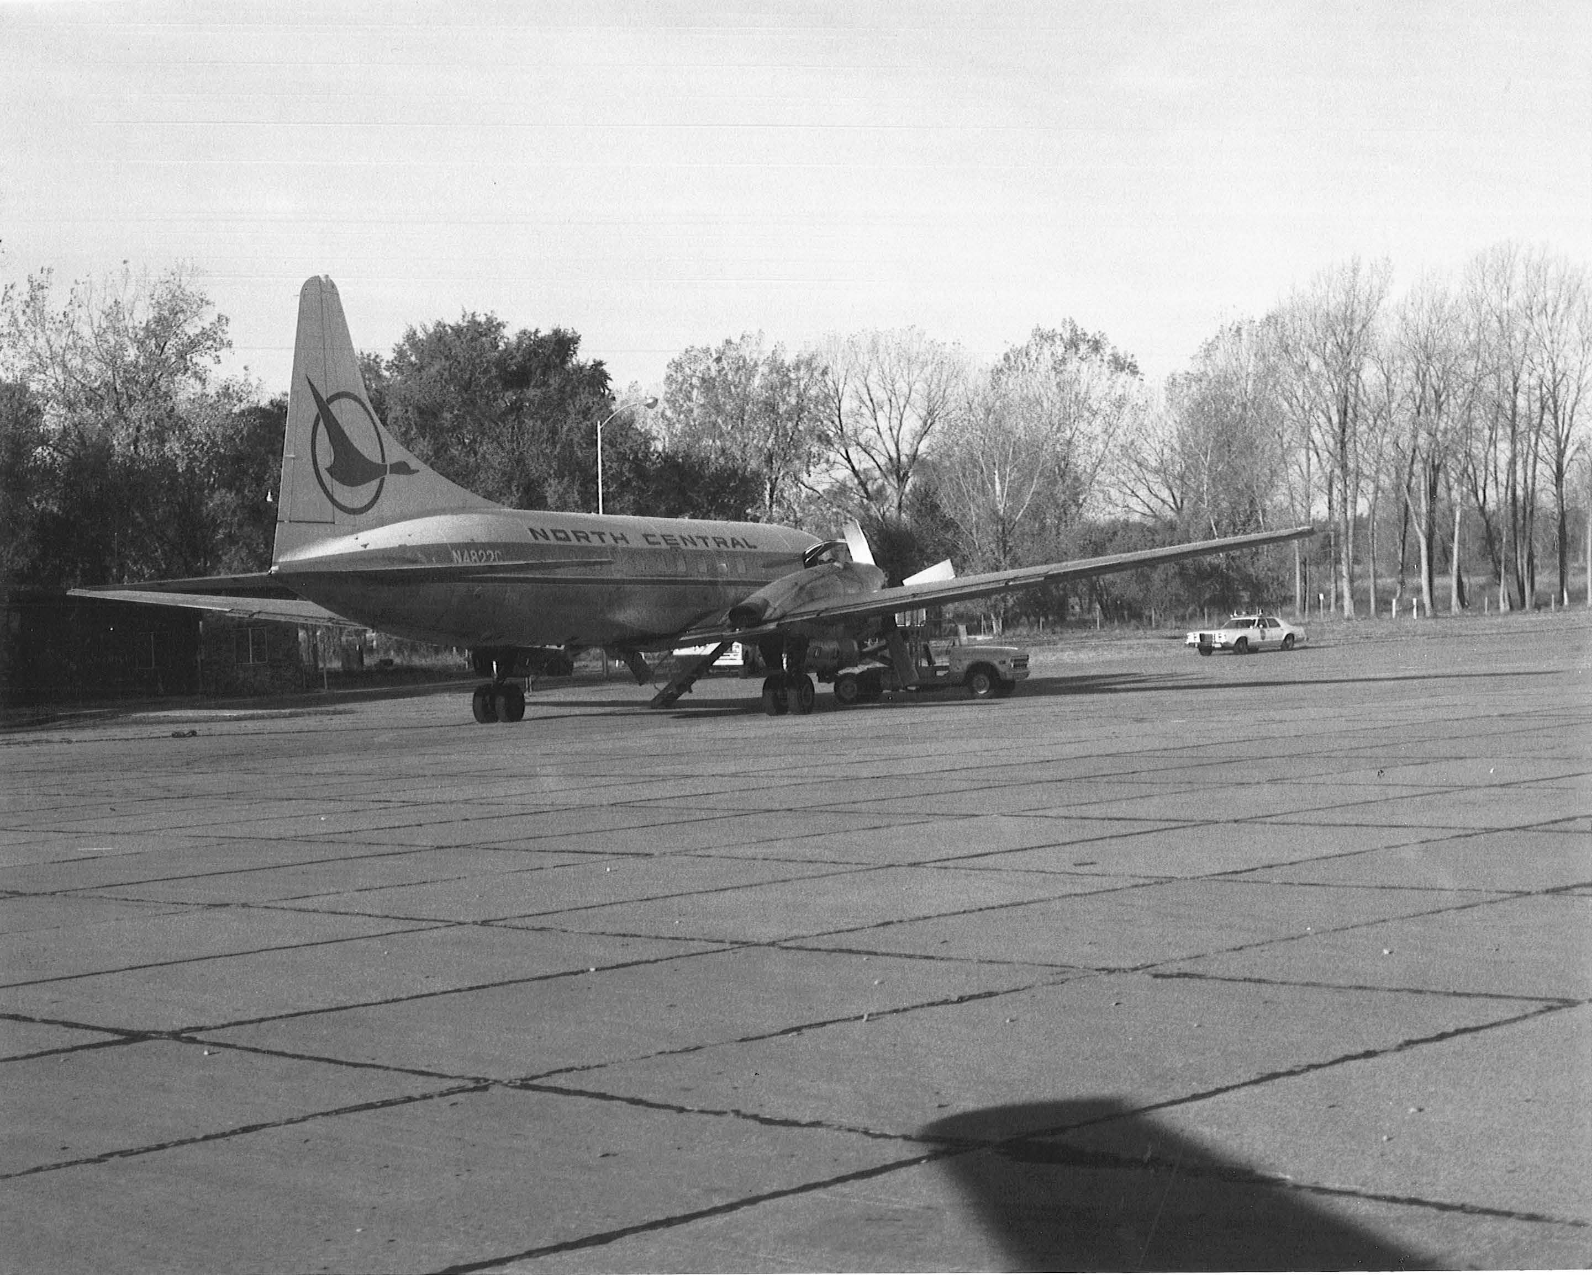
Convair 580 at Mitchell

Slide 23
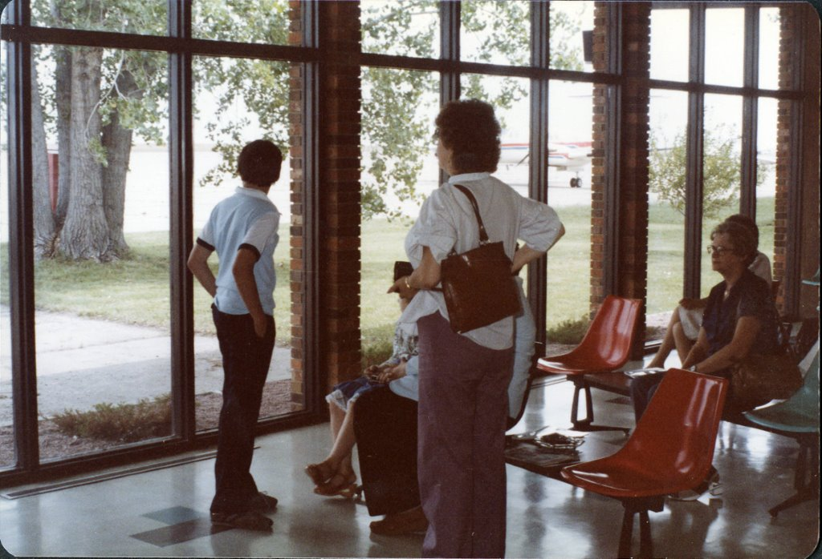
Inside the George McGovern Terminal

Slide 24
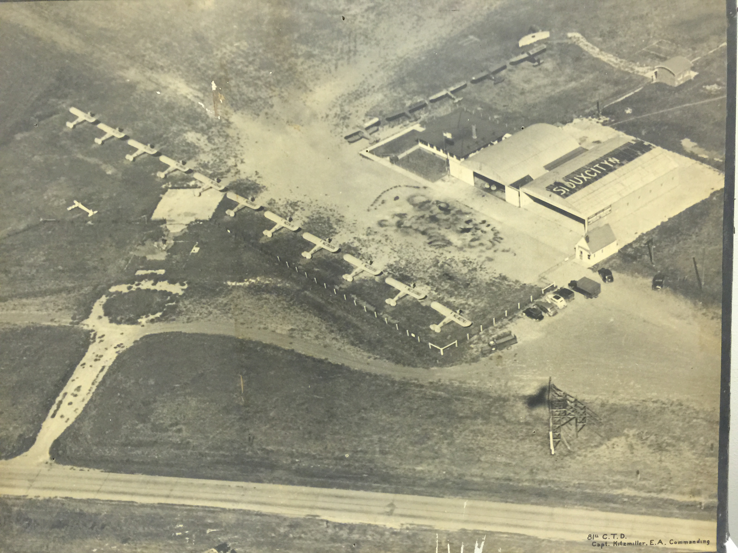
North Sioux City-Graham Field

Slide 25
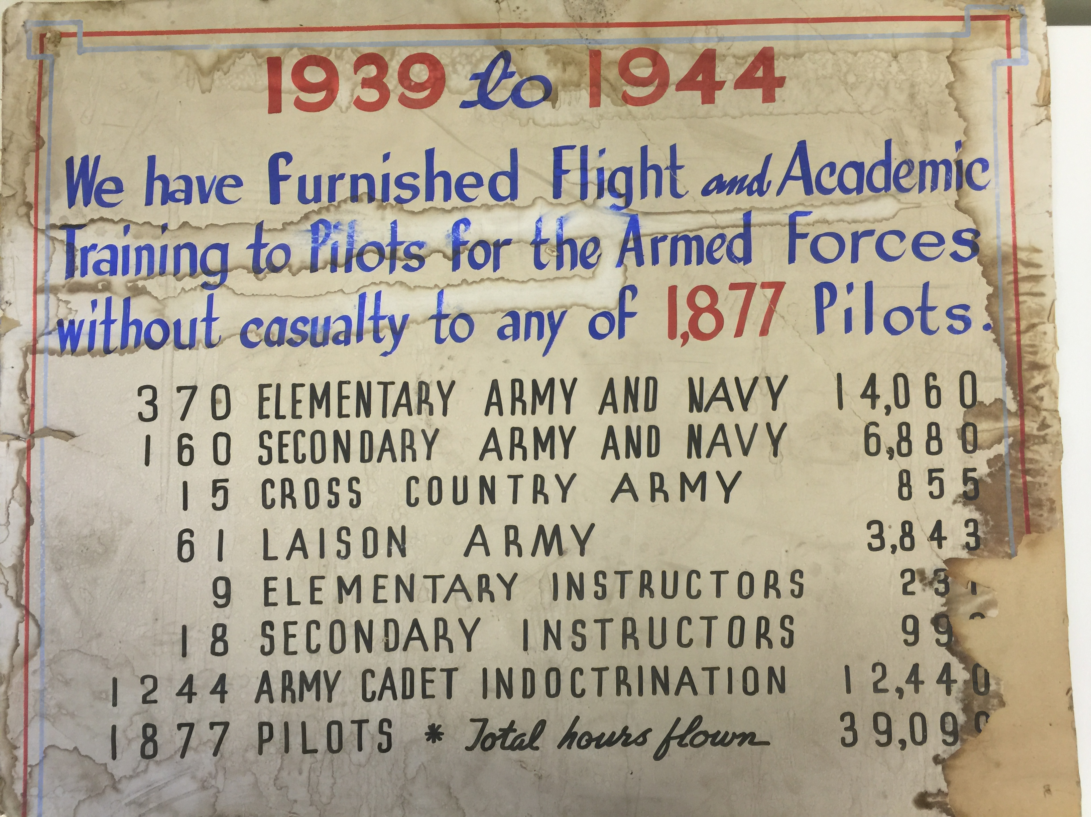
North Sioux City was an Army Training School

Slide 26
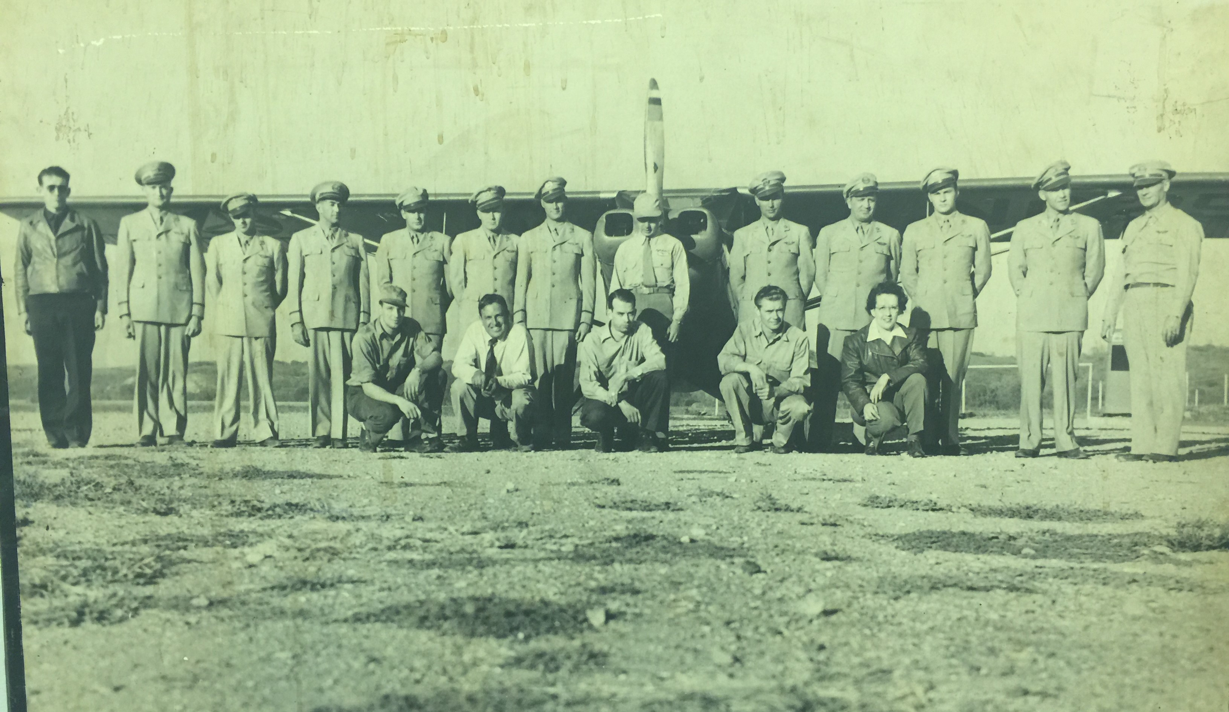
Flight School at Graham Field

Slide 27
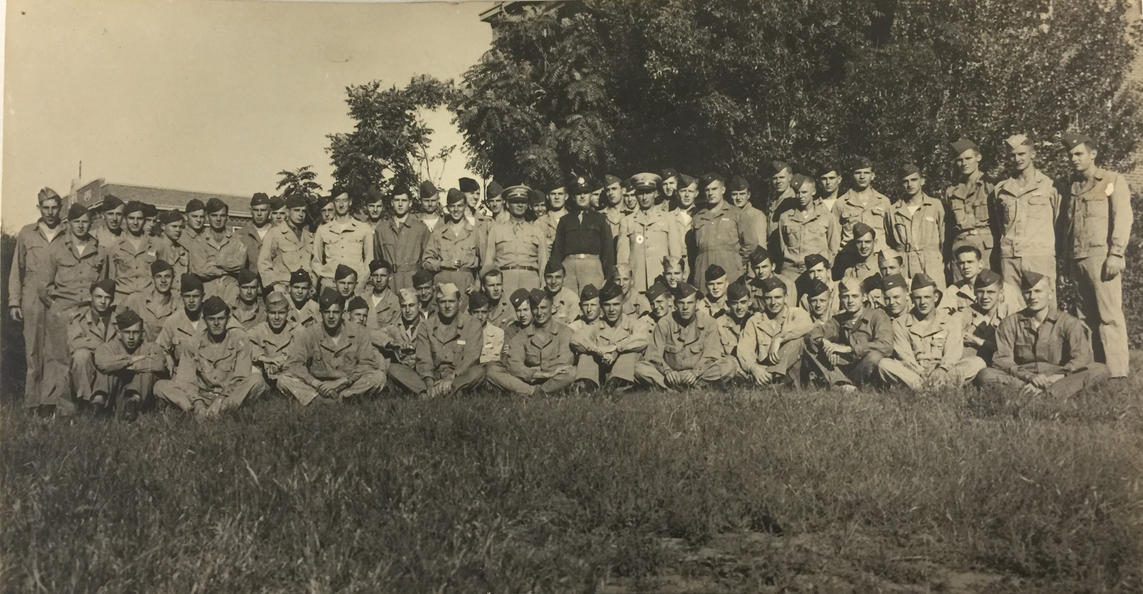
Graham Field Flight Students

Slide 28
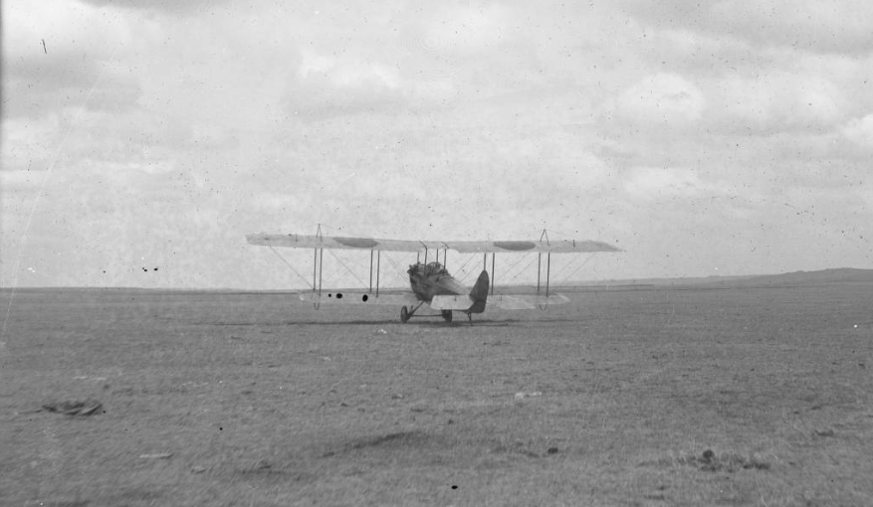
Biplane at Philip

Slide 29
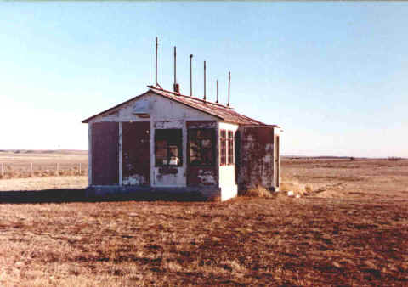
Philip Flight Service

Slide 30
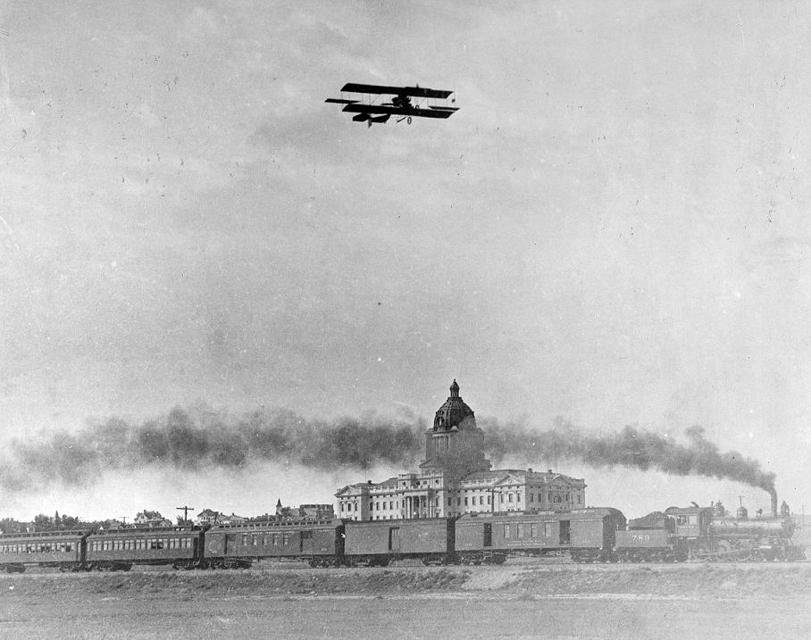
Pierre – Hugh Robinson’s Curtiss D over Capitol 1915

Slide 31
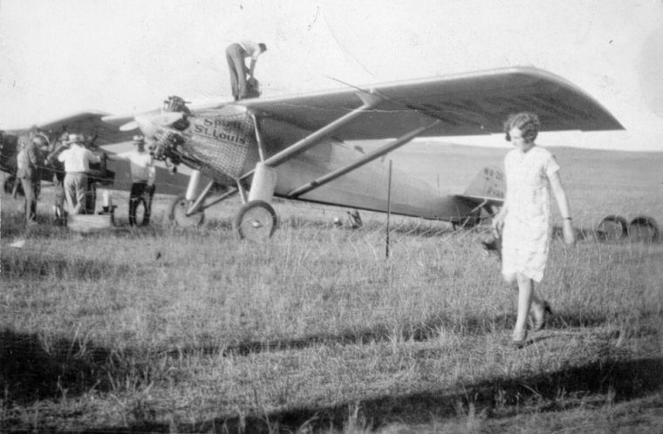
Lindbergh Landing – North of Pierre 1927

Slide 32
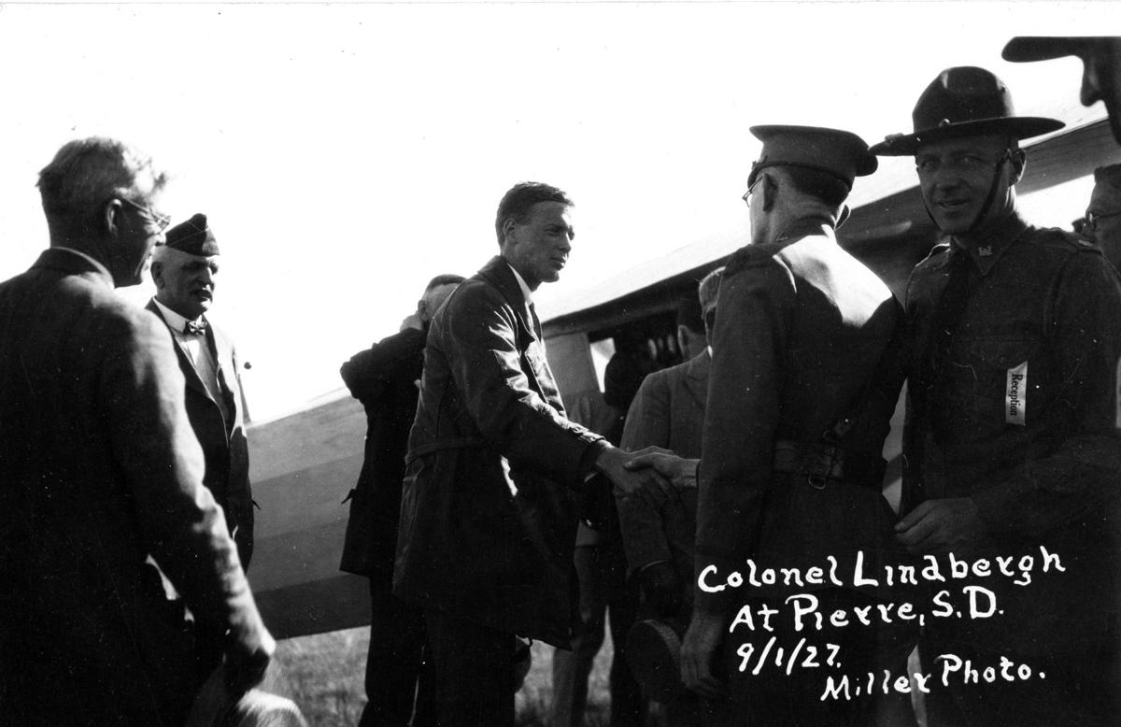

Slide 33
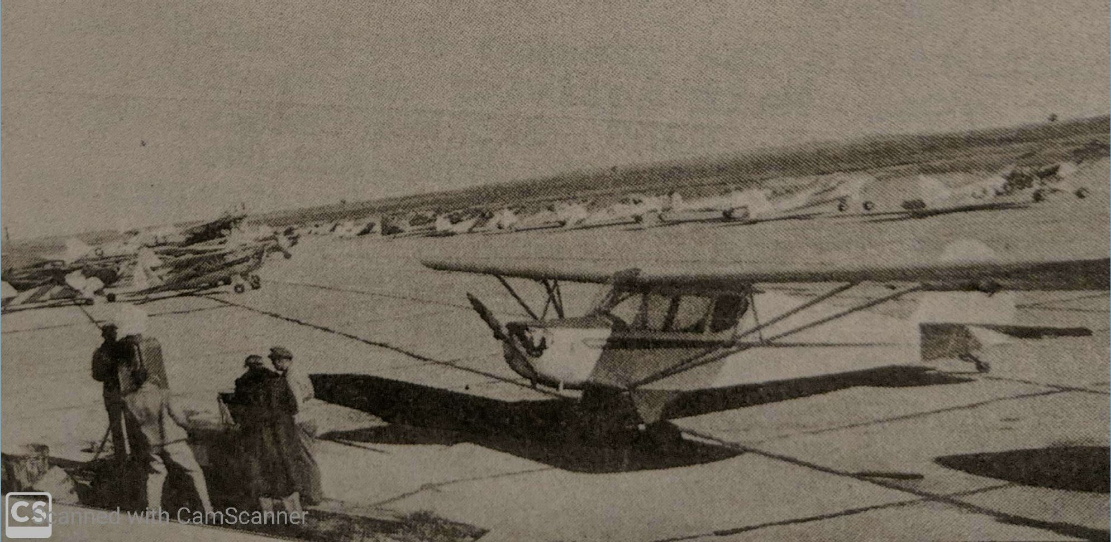
CAP Exercise 1952

Slide 34
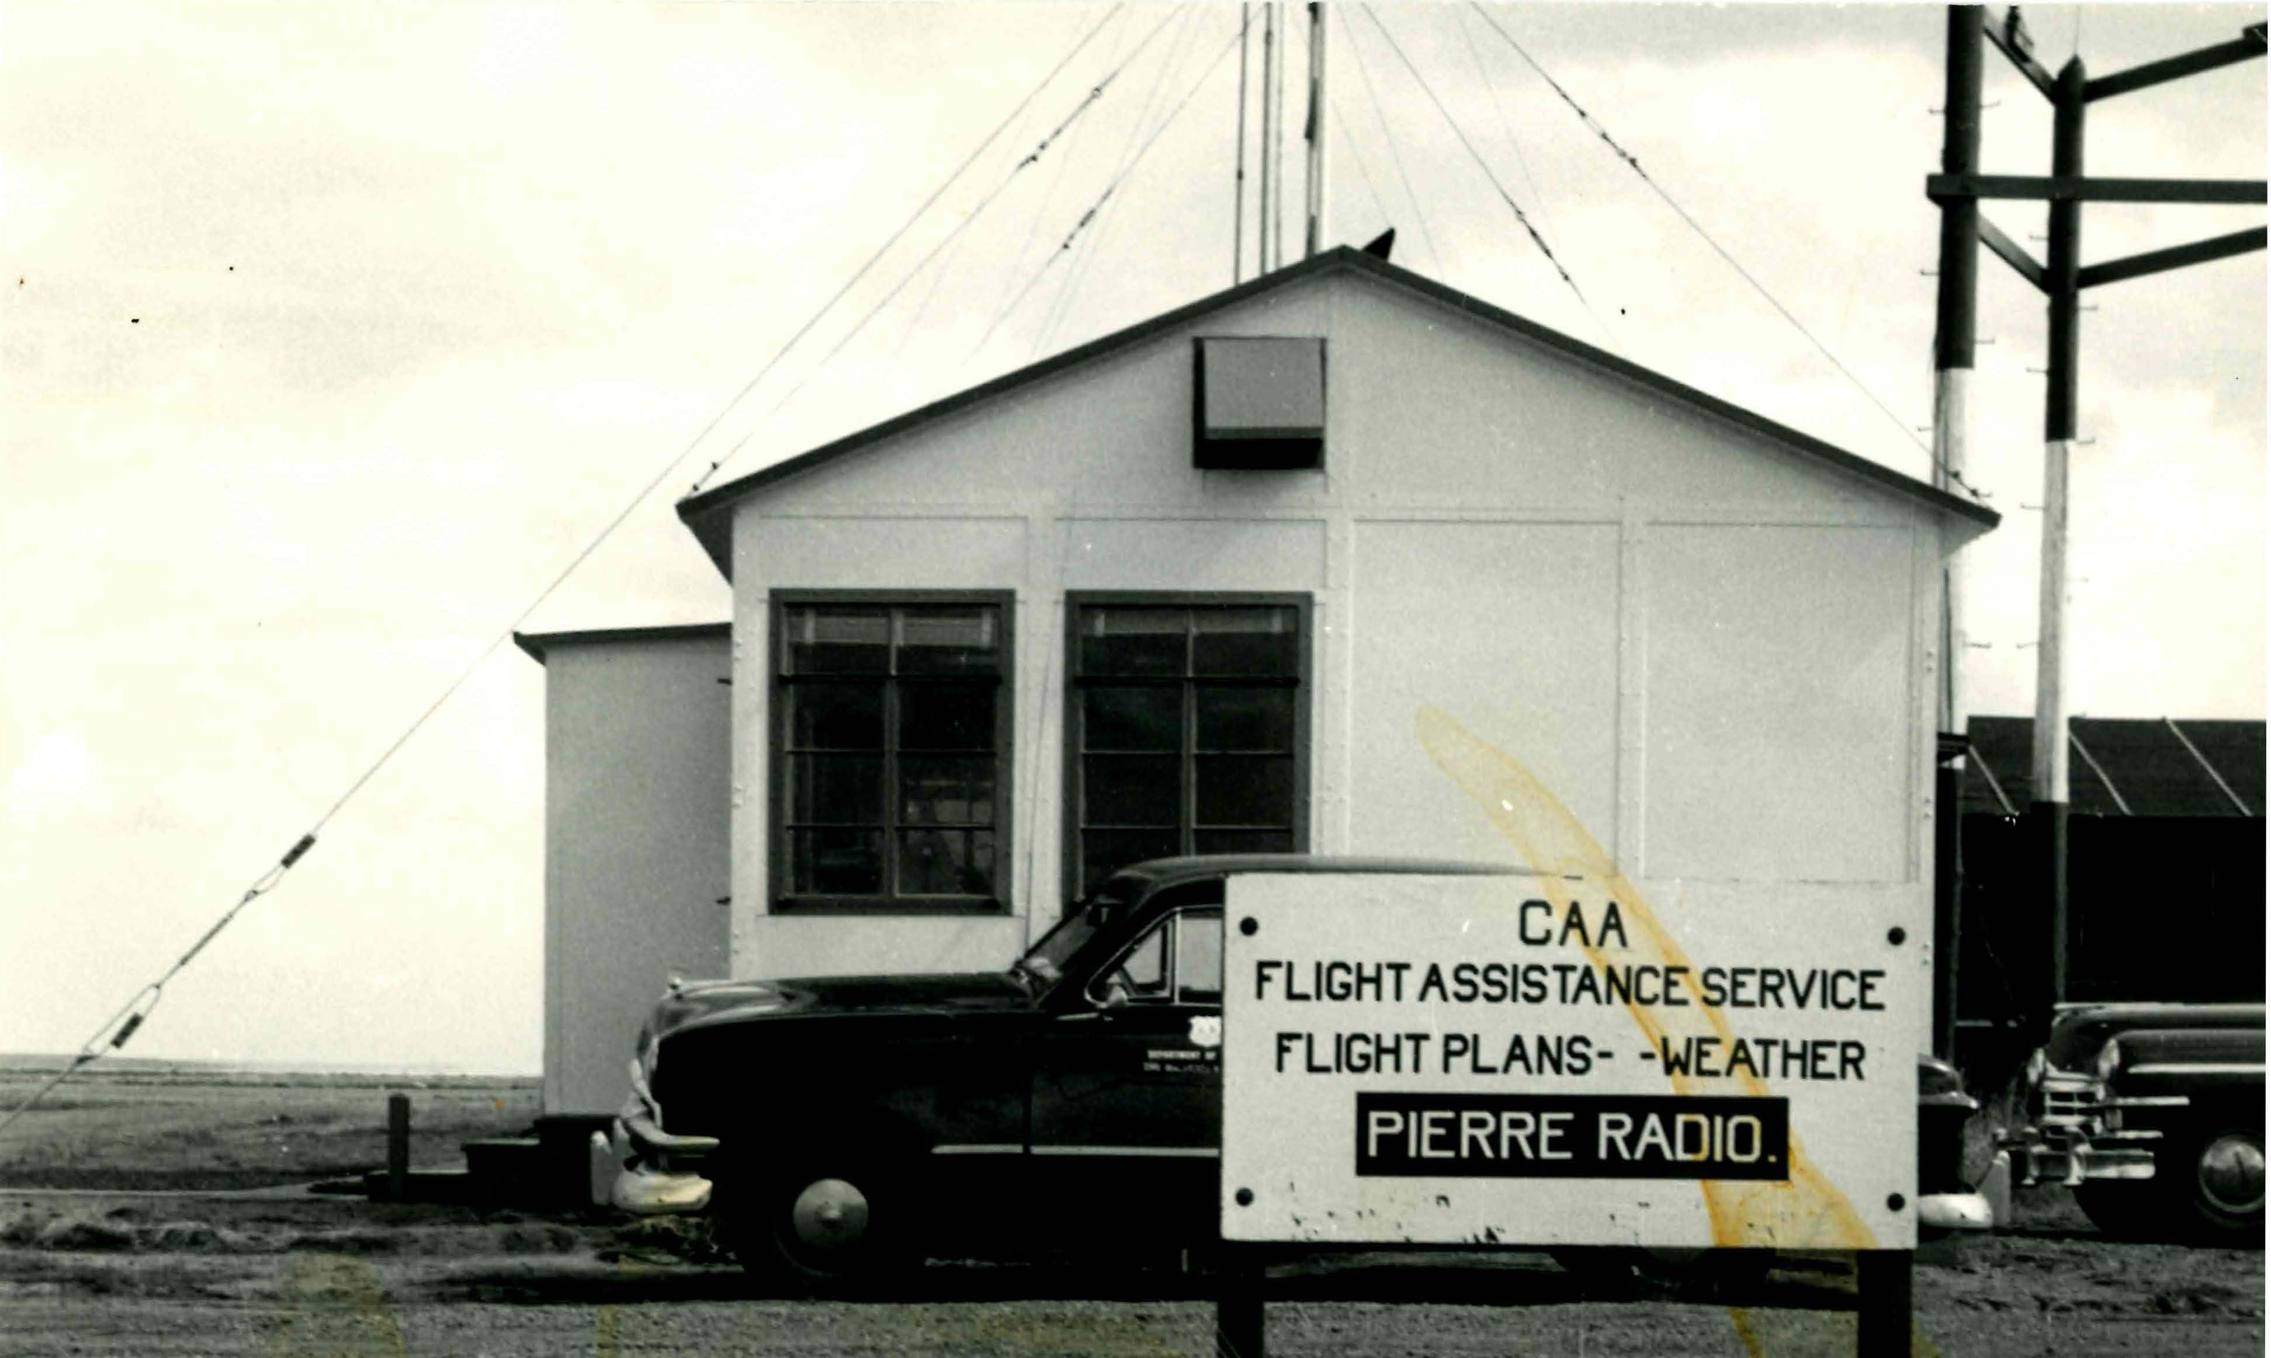
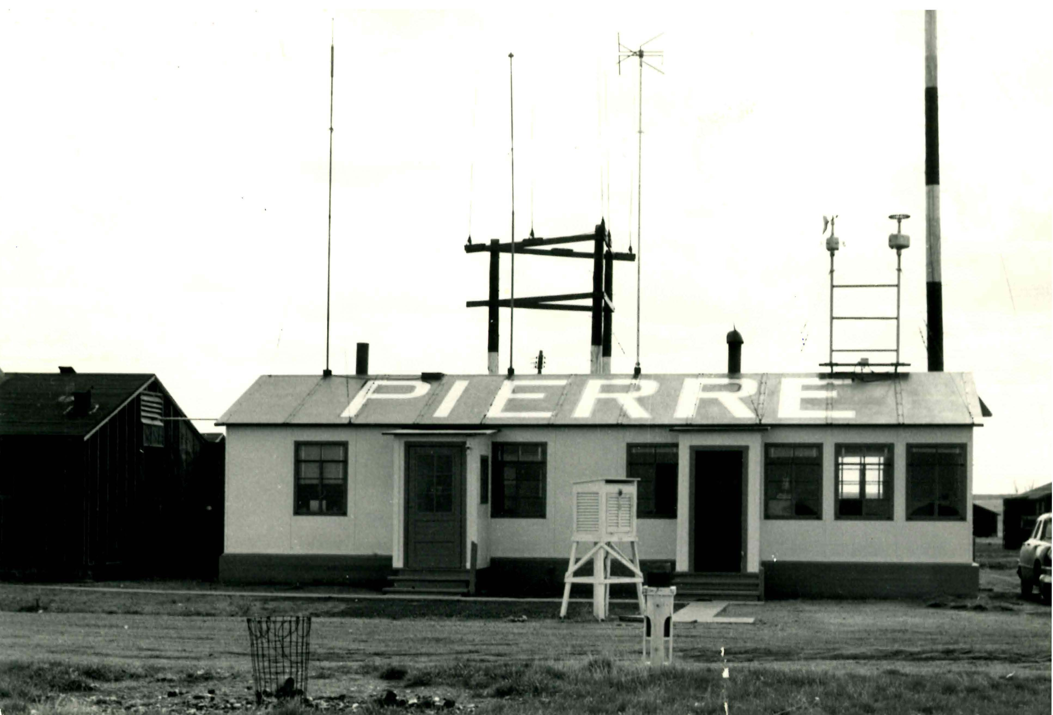
Pierre CAA Building

Slide 35
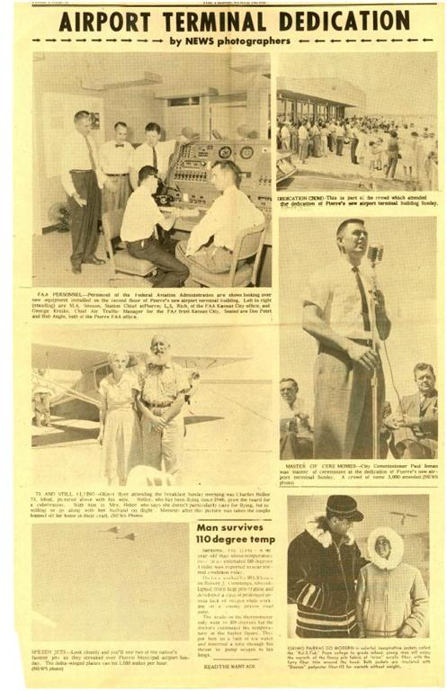
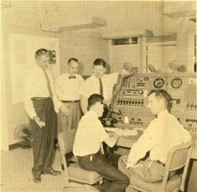
Terminal Dedication – New FSS 1960

Slide 36
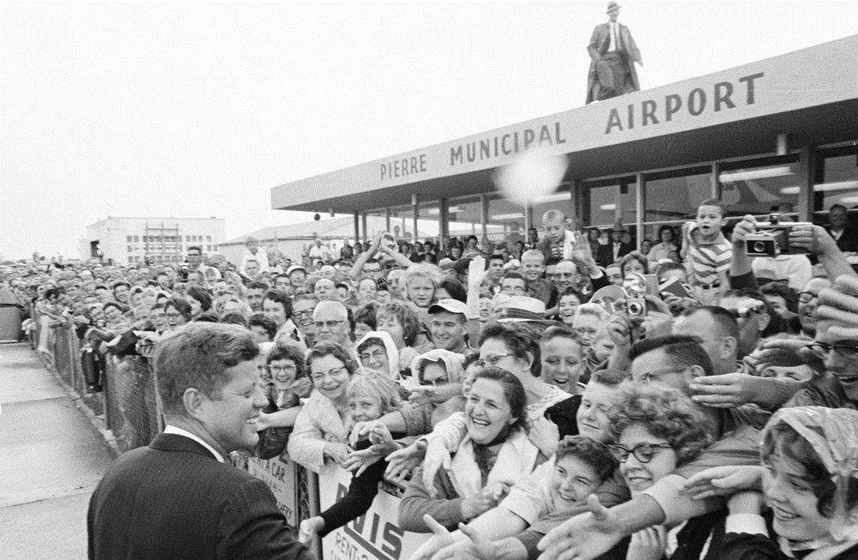
President Kennedy Visits 1962

Slide 37
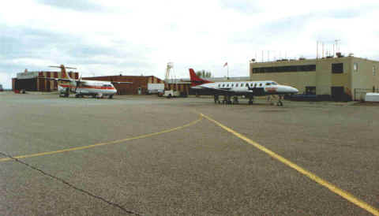
Pierre 1990. Continental Express ATR42 and Mesaba Metro

Slide 38
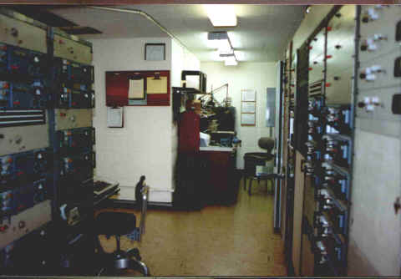
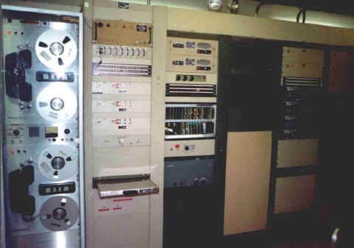
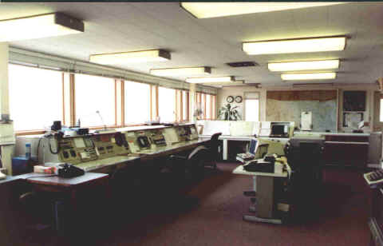
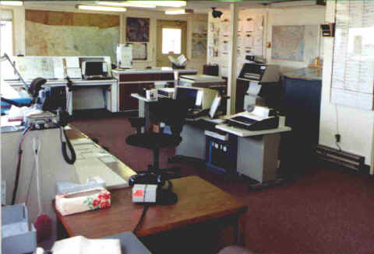
Pierre FSS 1990

Slide 39
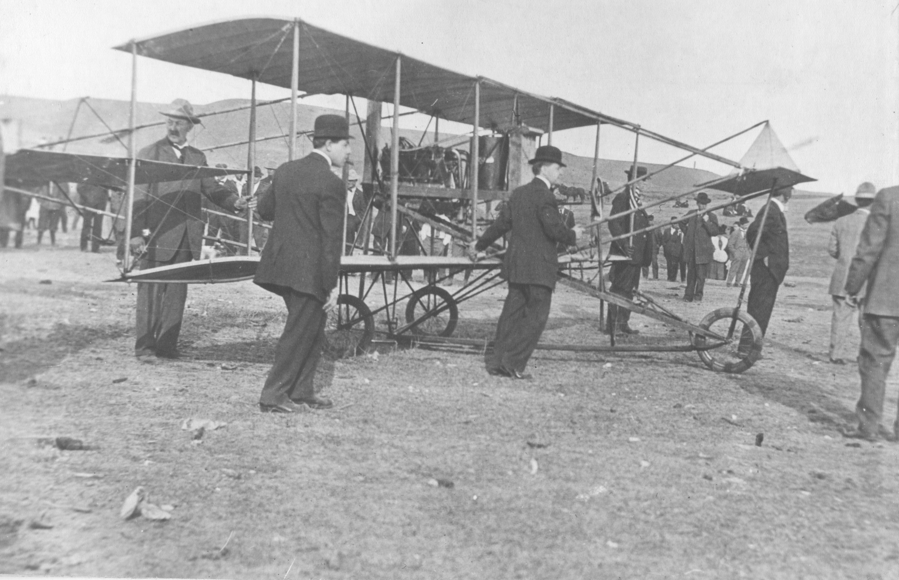
1st Plane in SD flew at Rapid City 1911

Slide 40
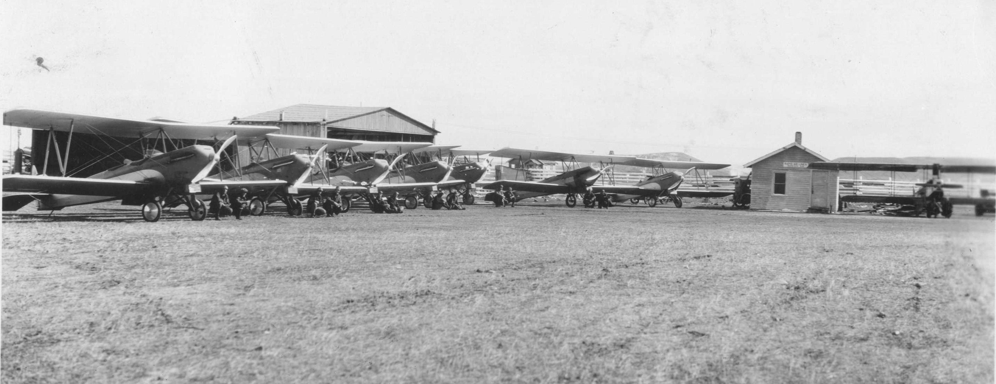
Rapid Air Lines

Slide 41
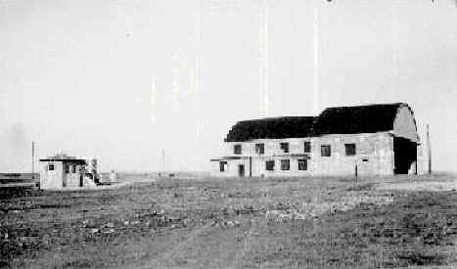
NWS Building and Rapid Airlines Hangar 1939 – Current Ellsworth Location

Slide 42
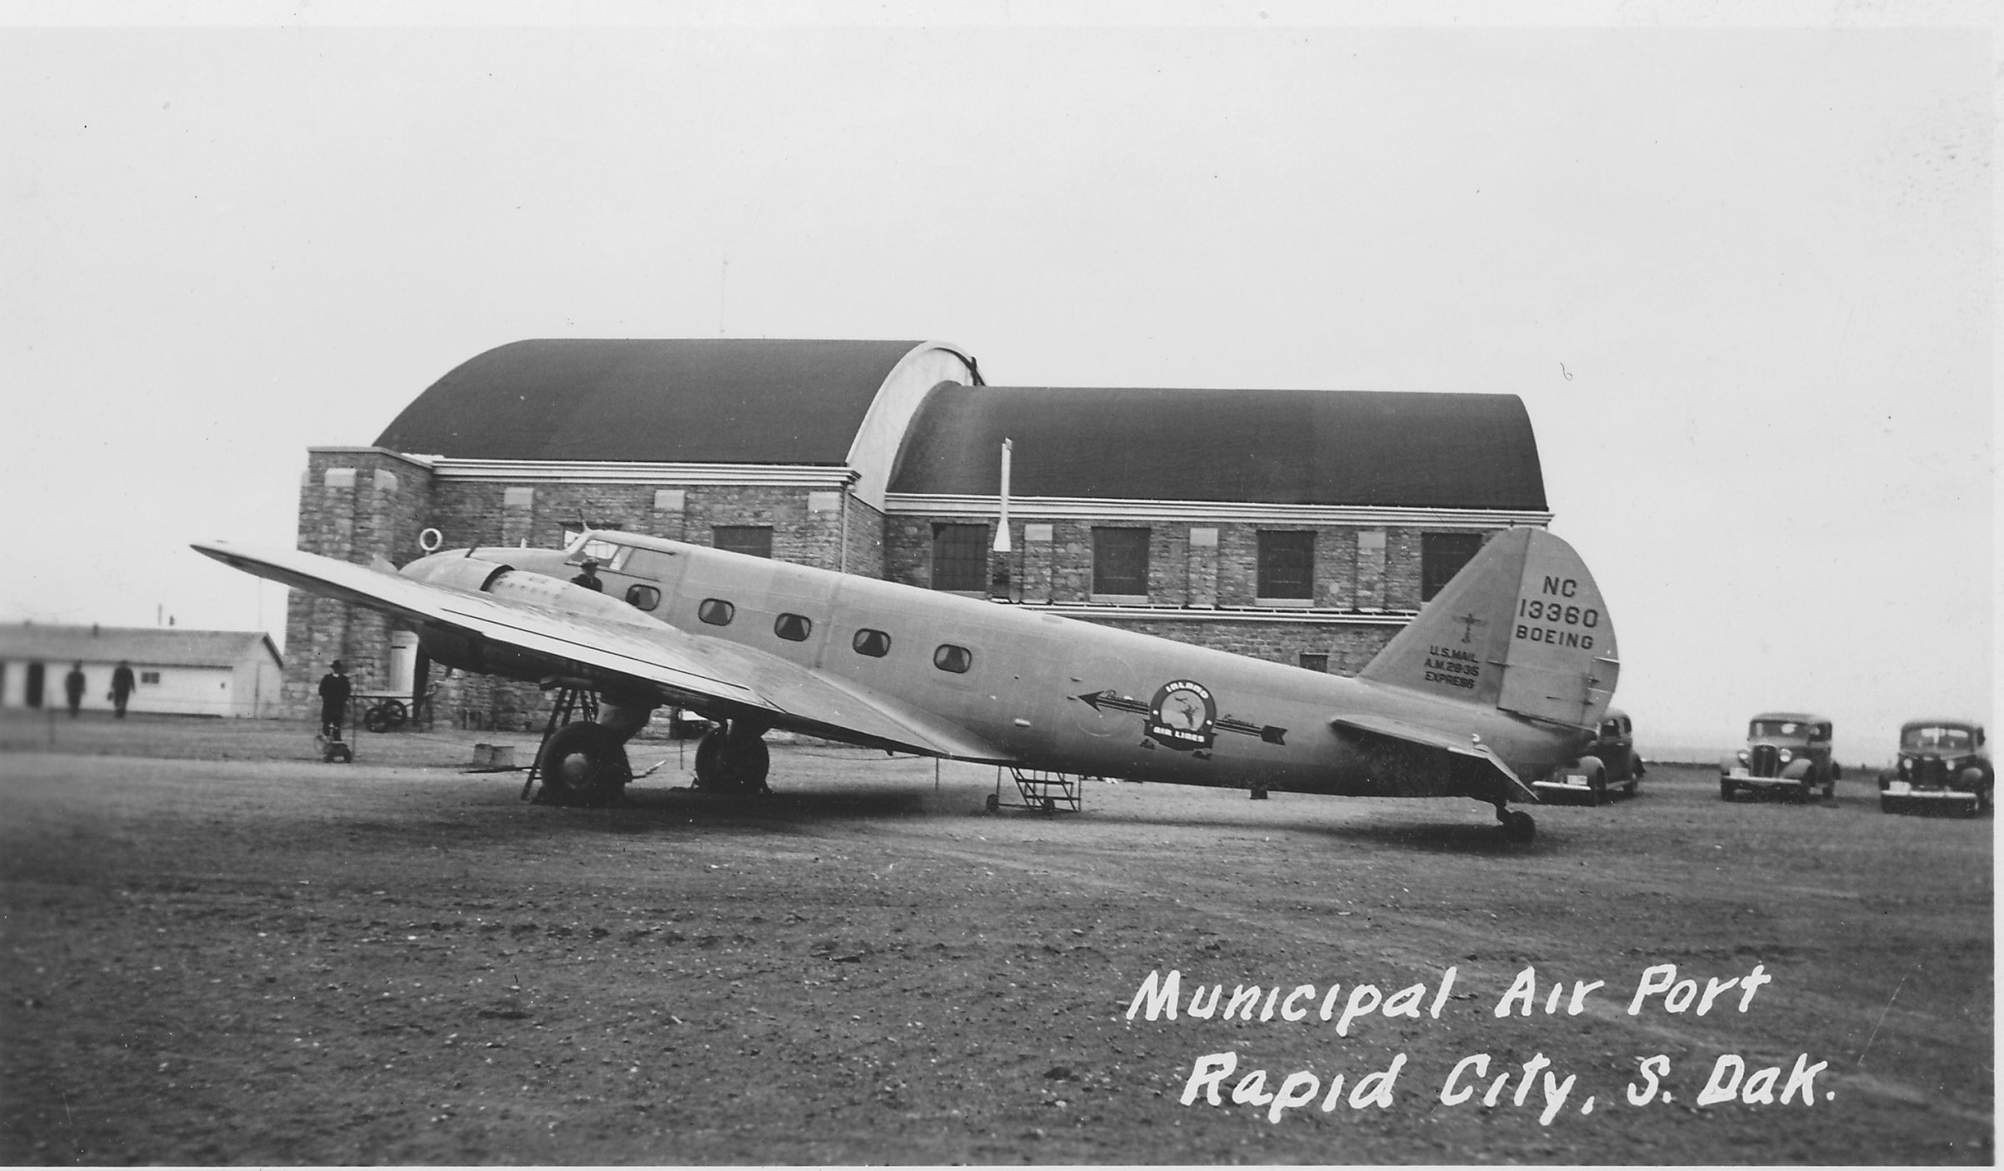
Inland Airlines at Rapid City

Slide 43
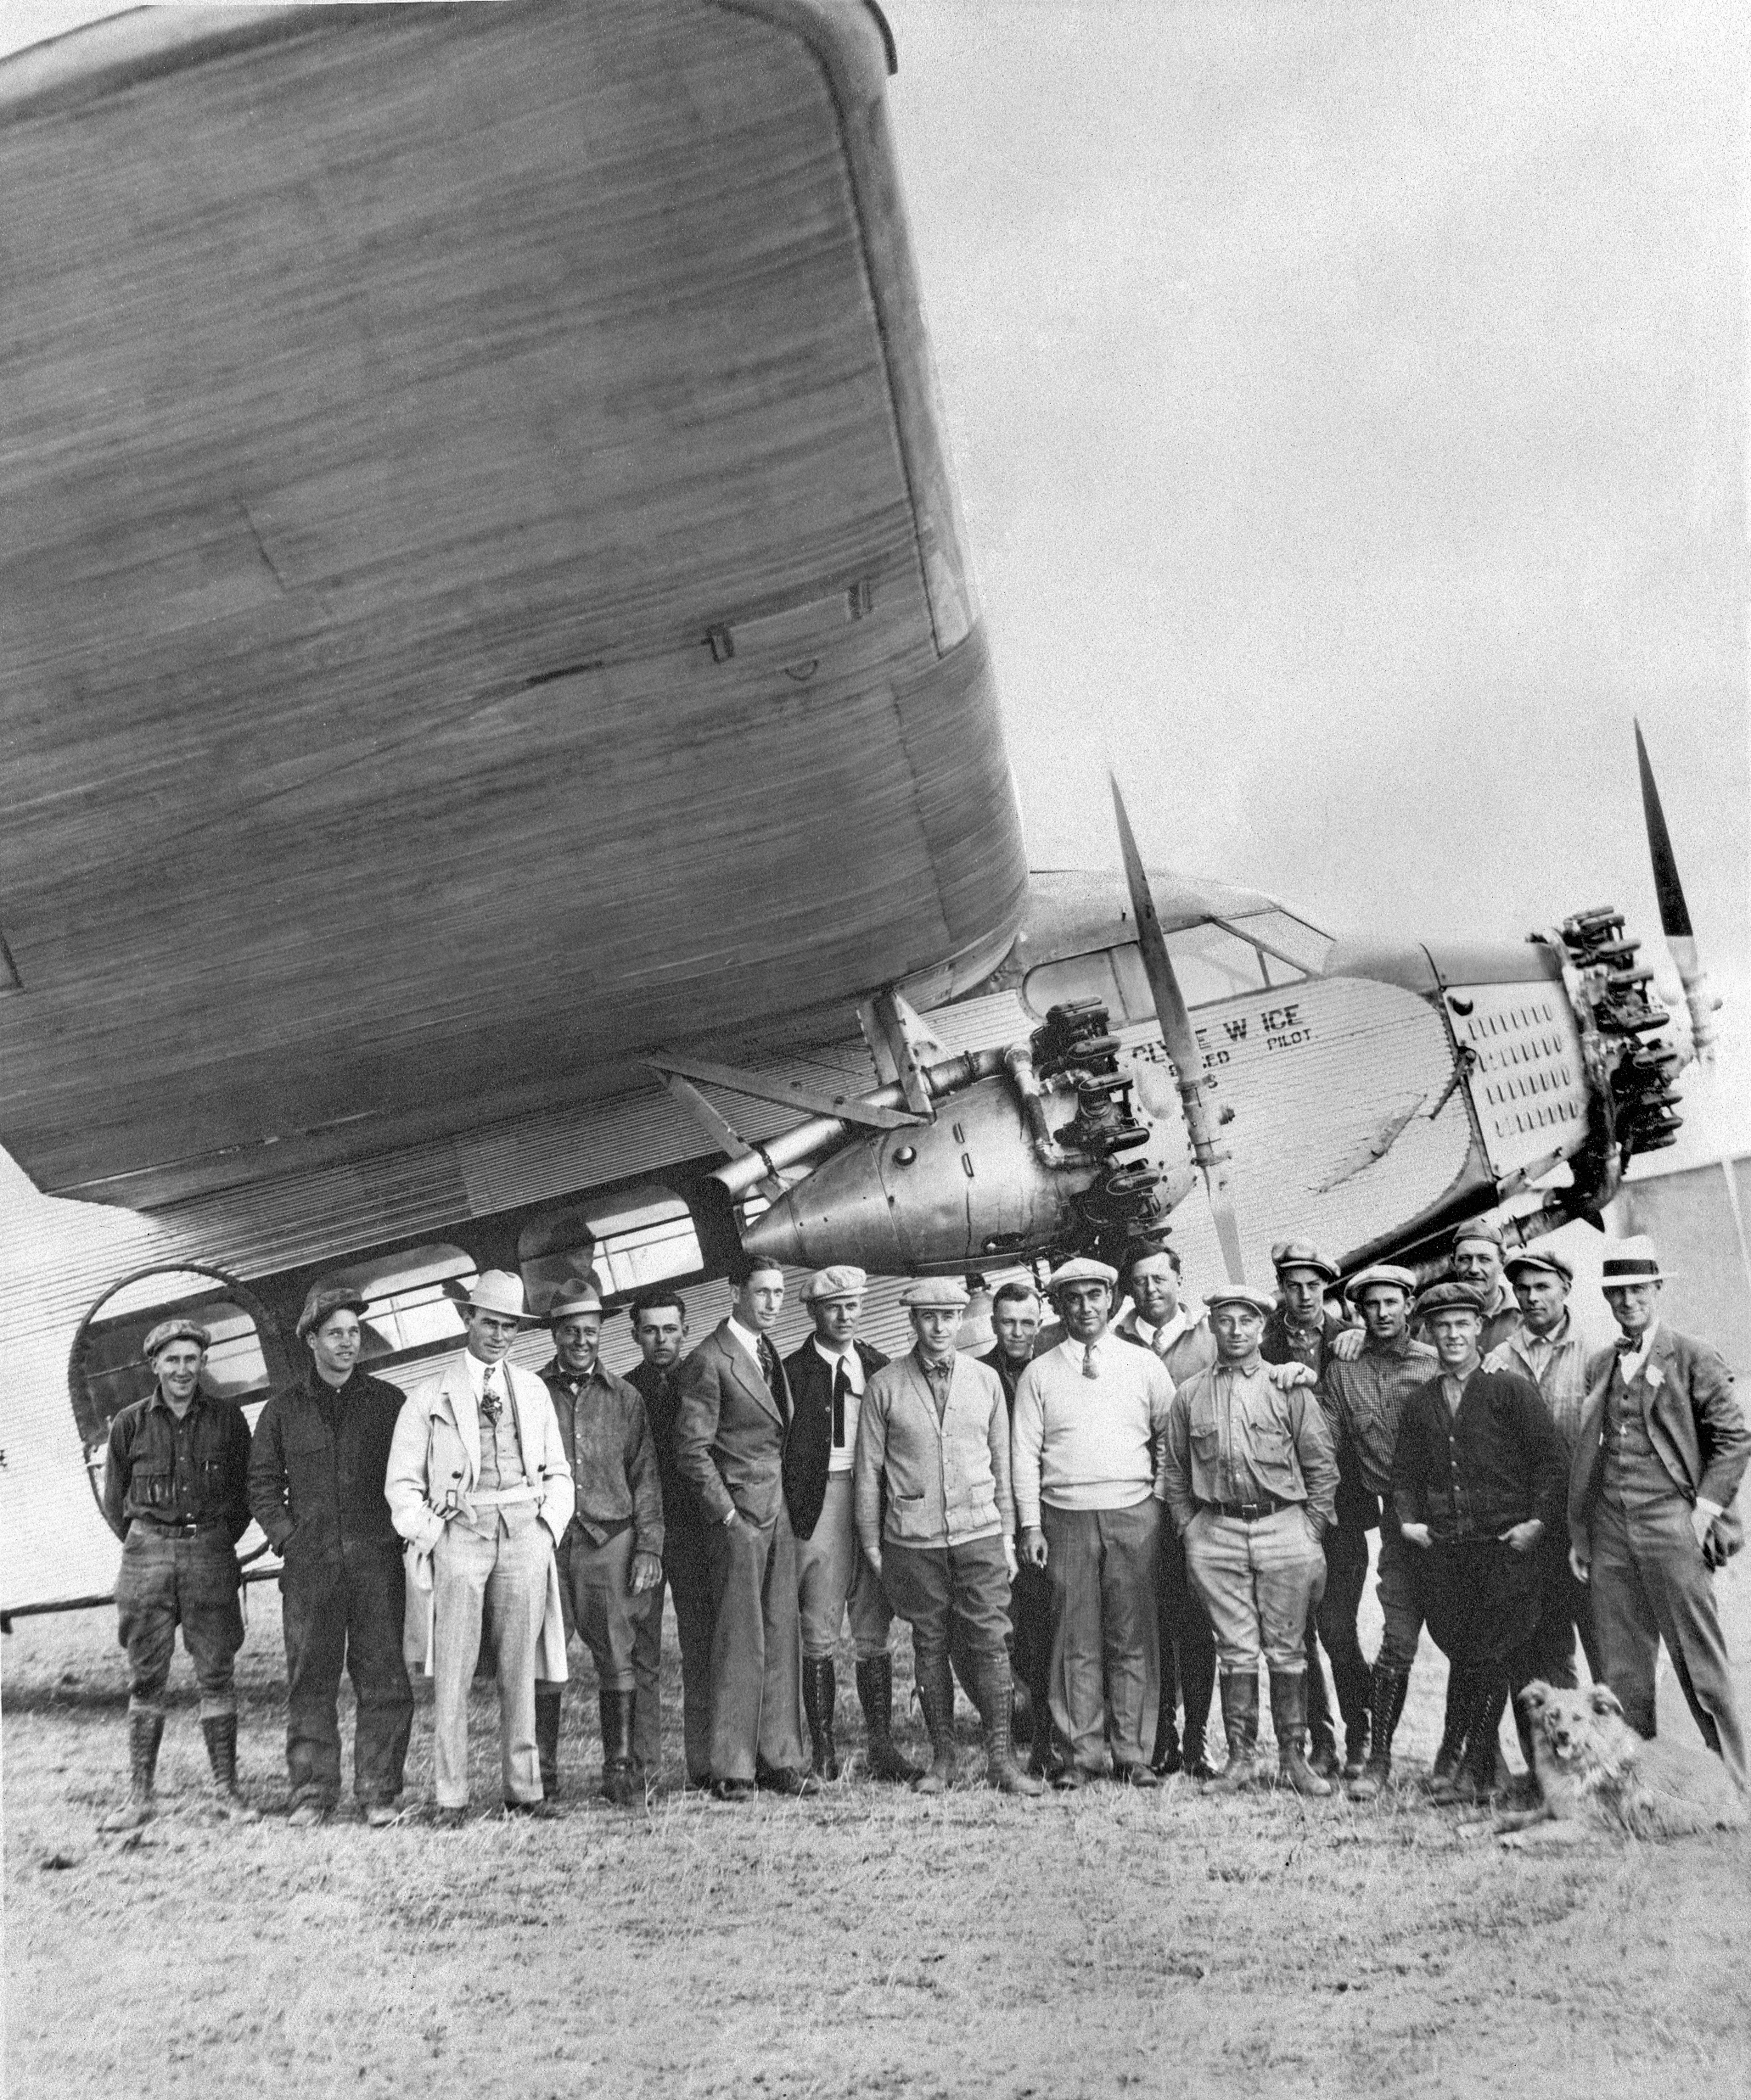
Clyde Ice’ Ford Trimotor

Slide 44
Halley Airport 1950

Slide 45
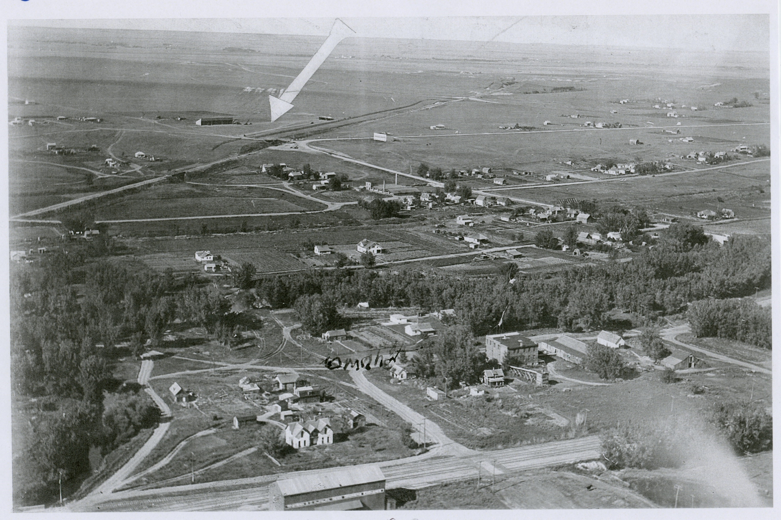
Halley Airport, Rapid City

Slide 46
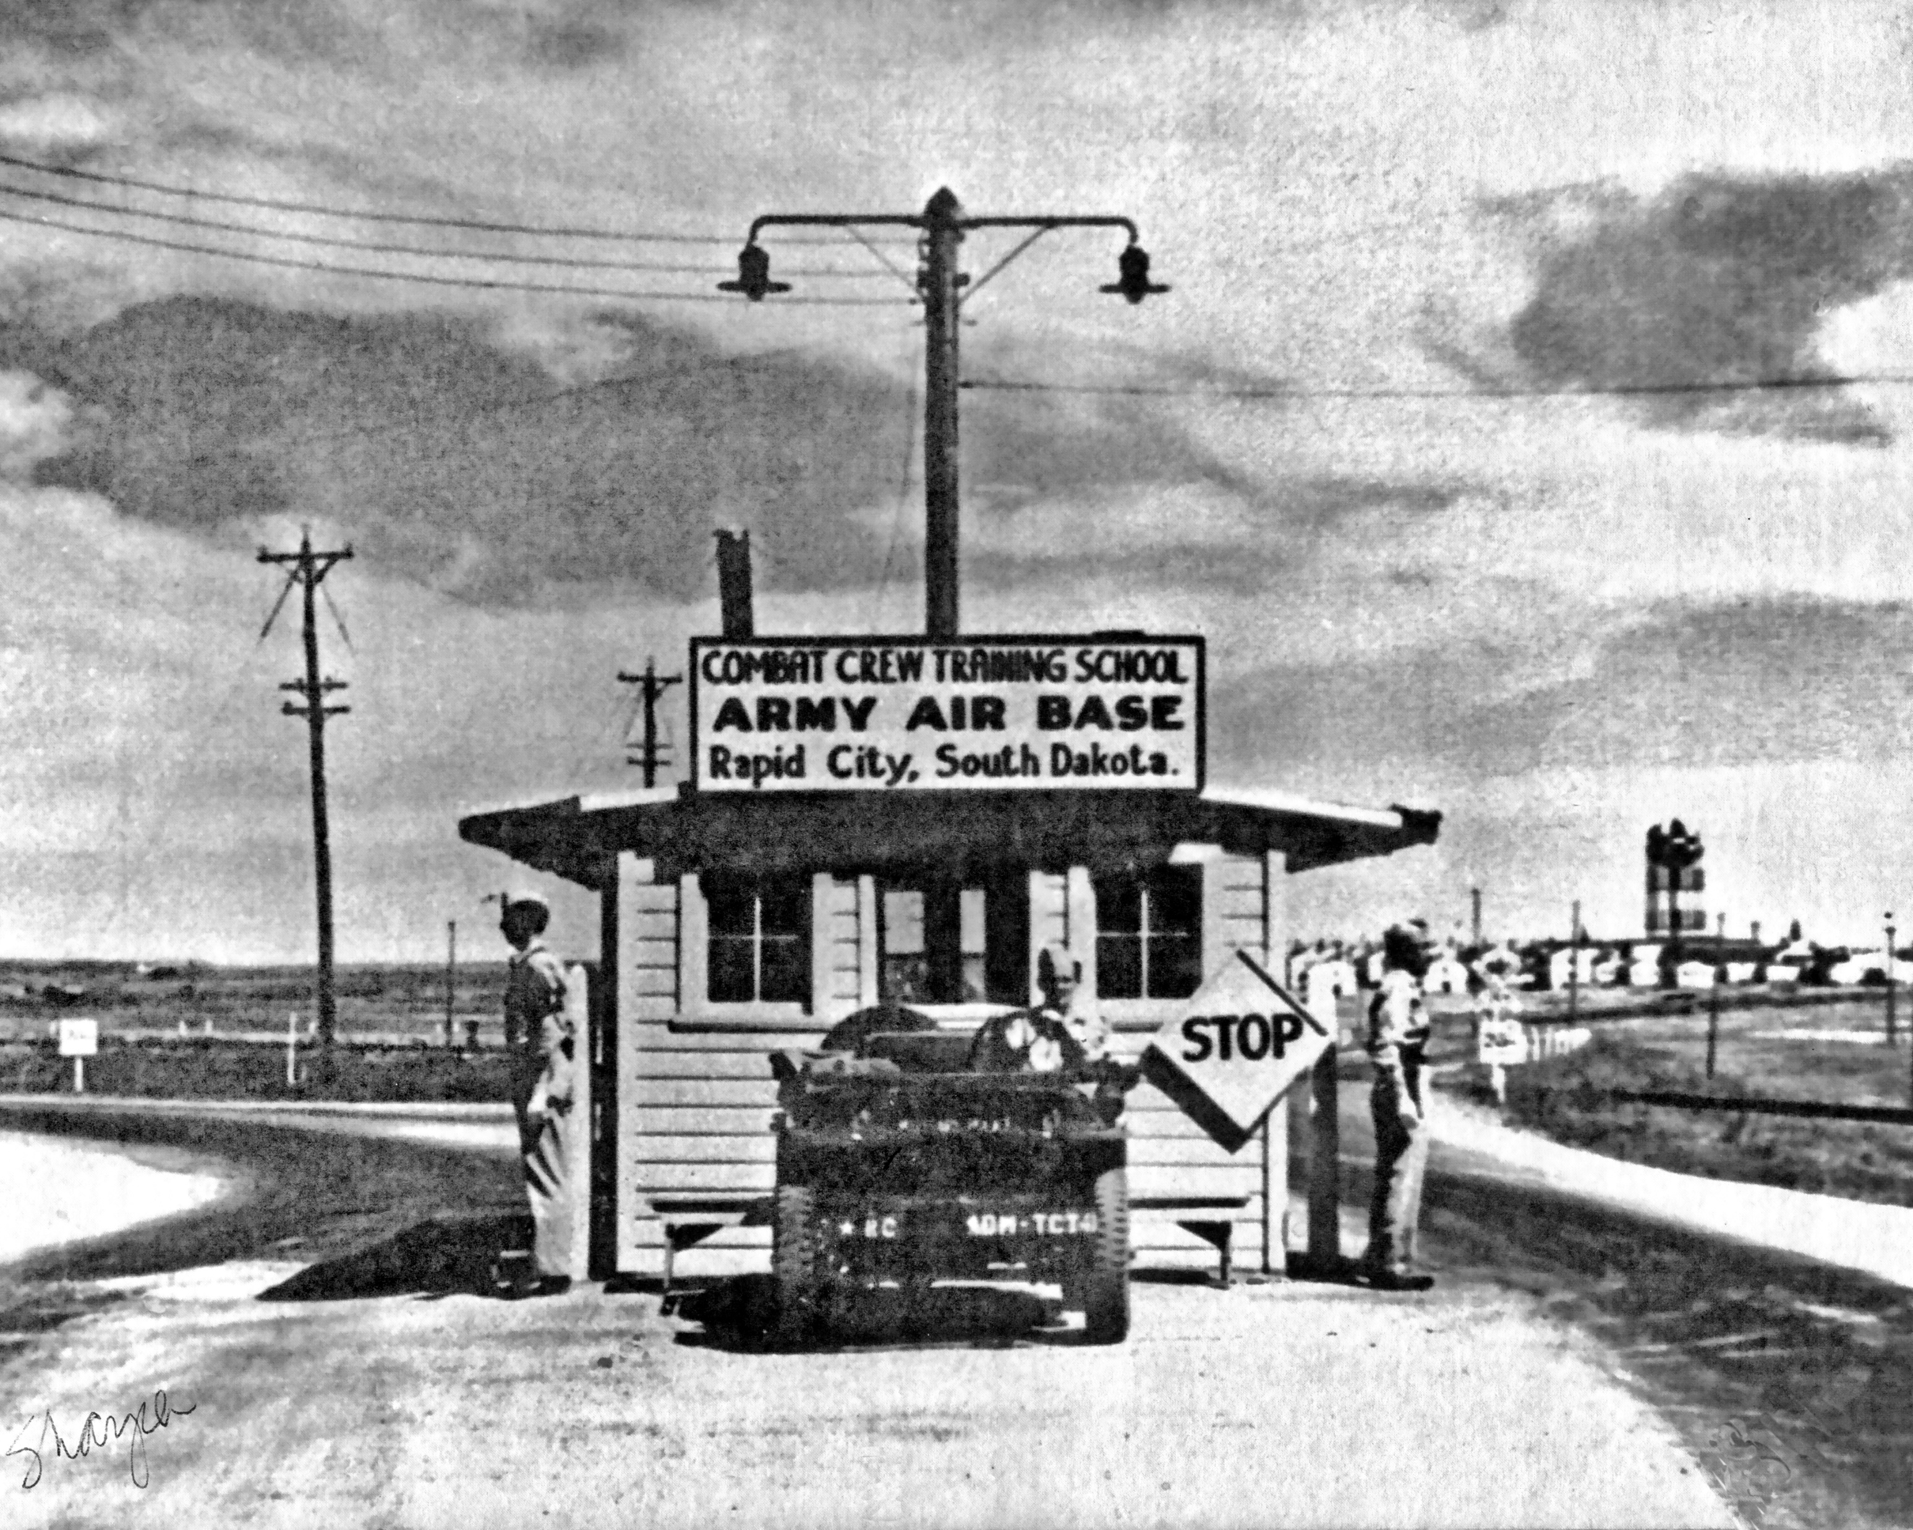
Halley Airport, Rapid City

Slide 47
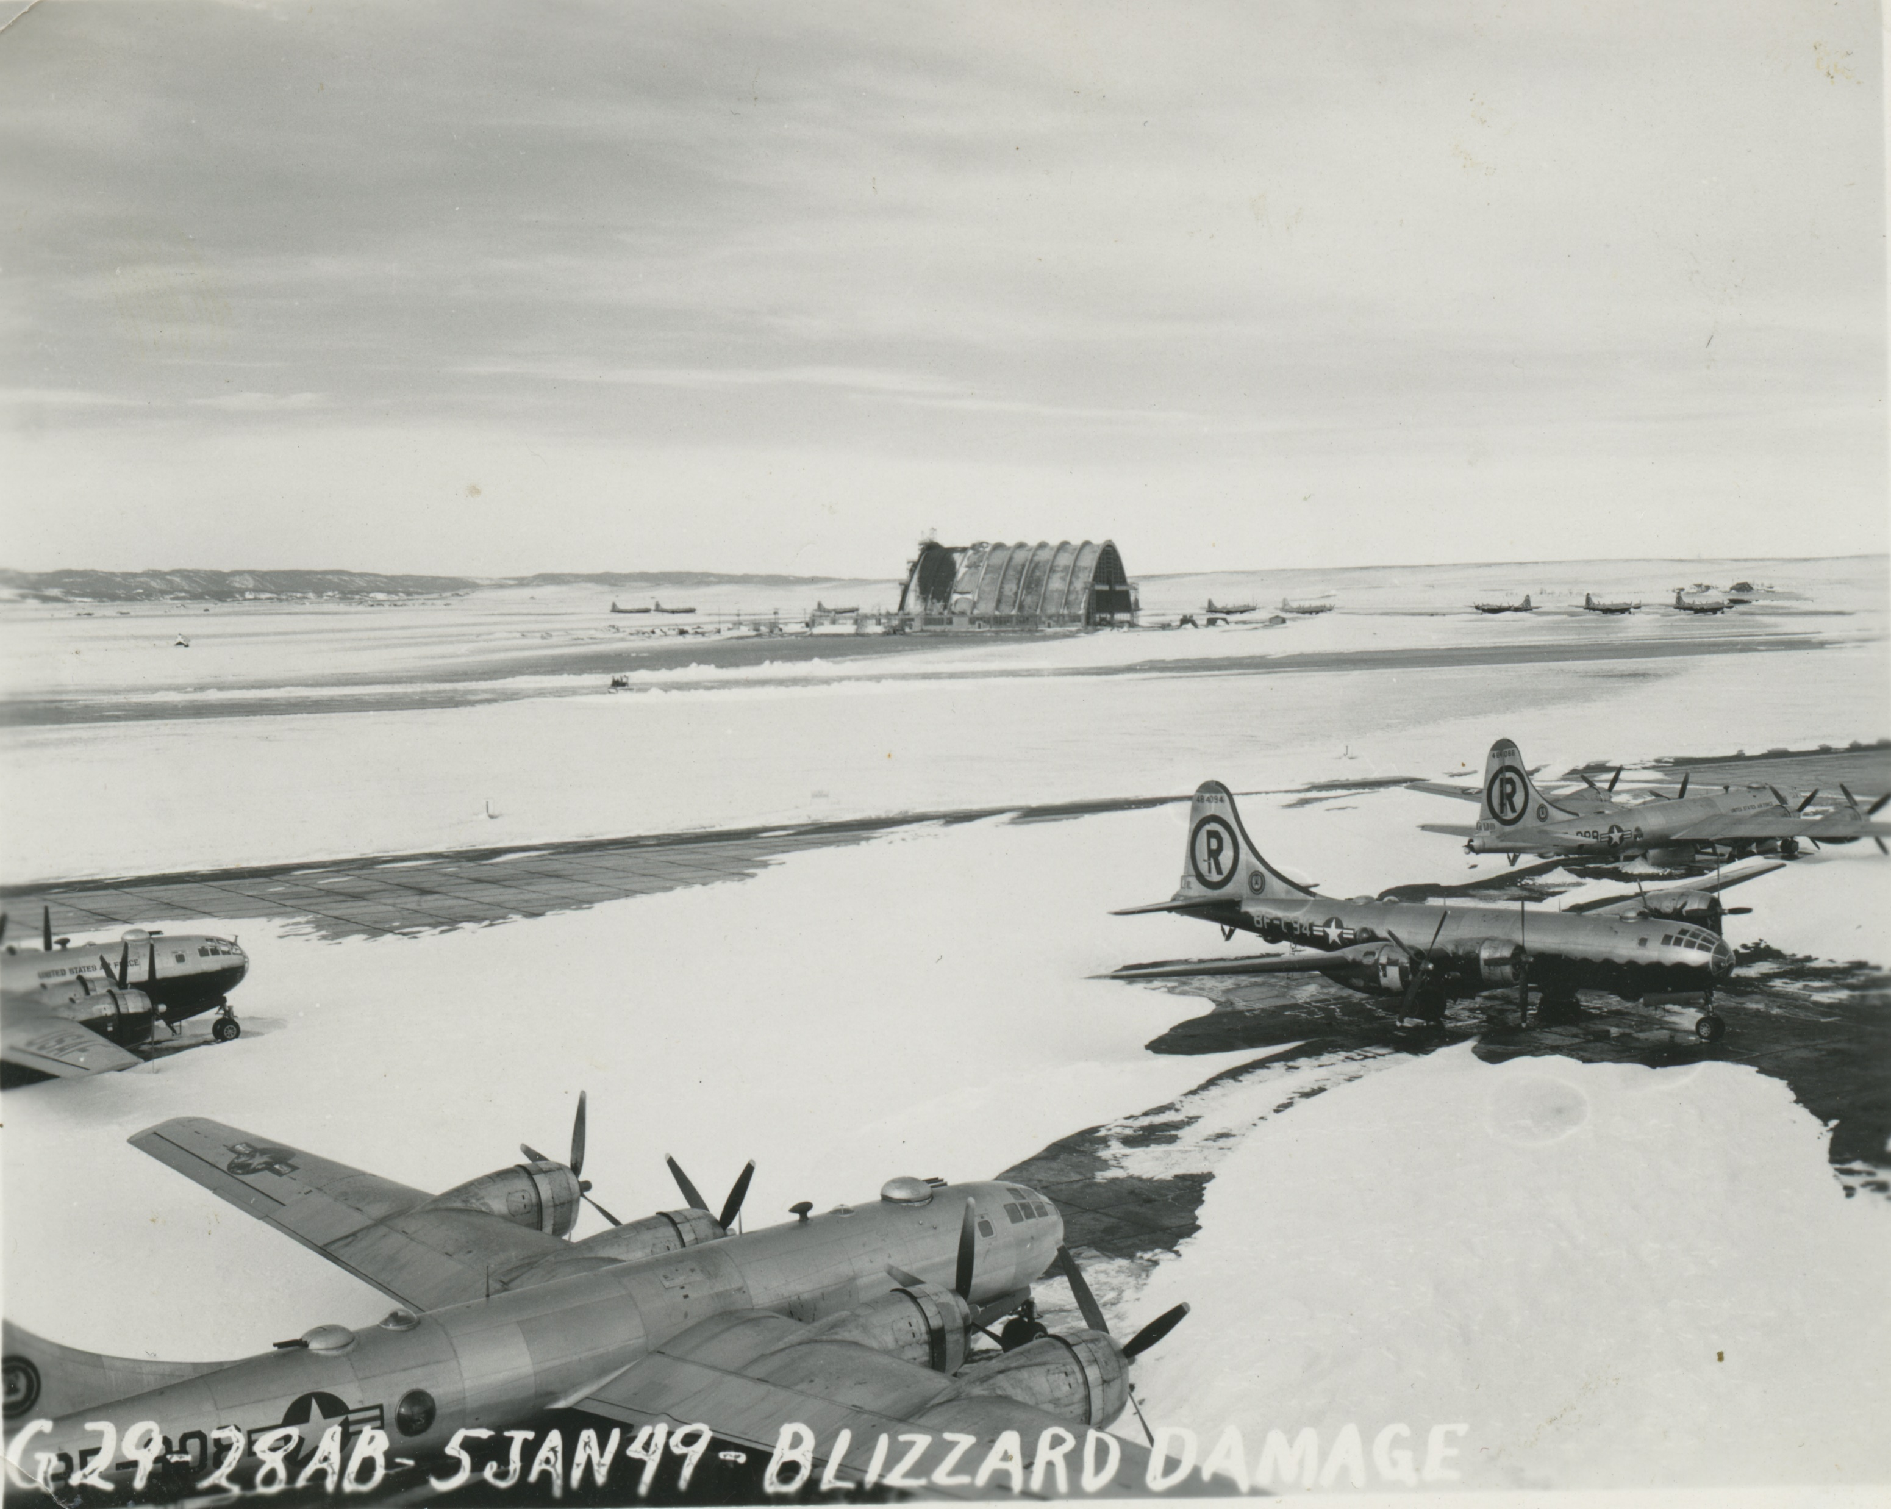
Ellsworth AFB

Slide 48
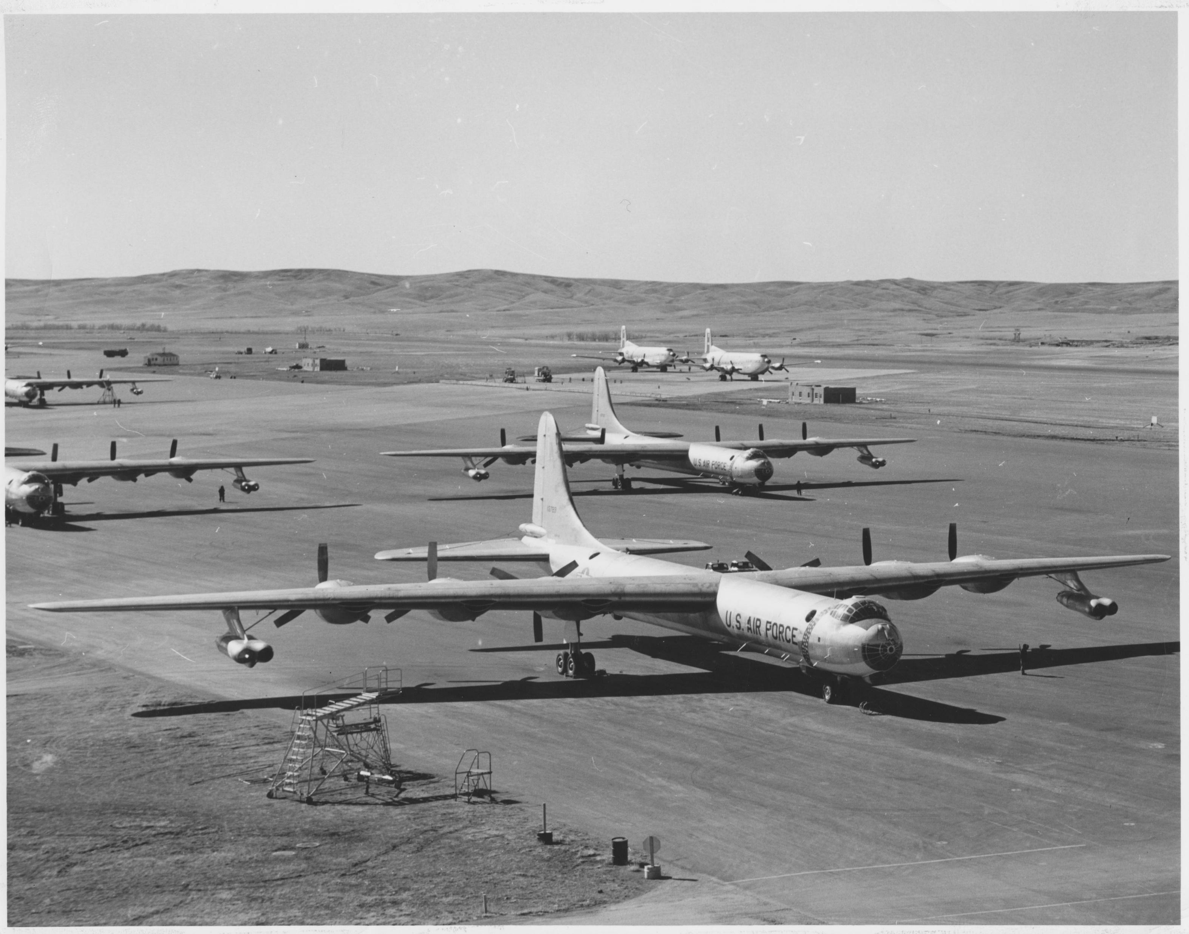
Ellsworth AFB

Slide 49
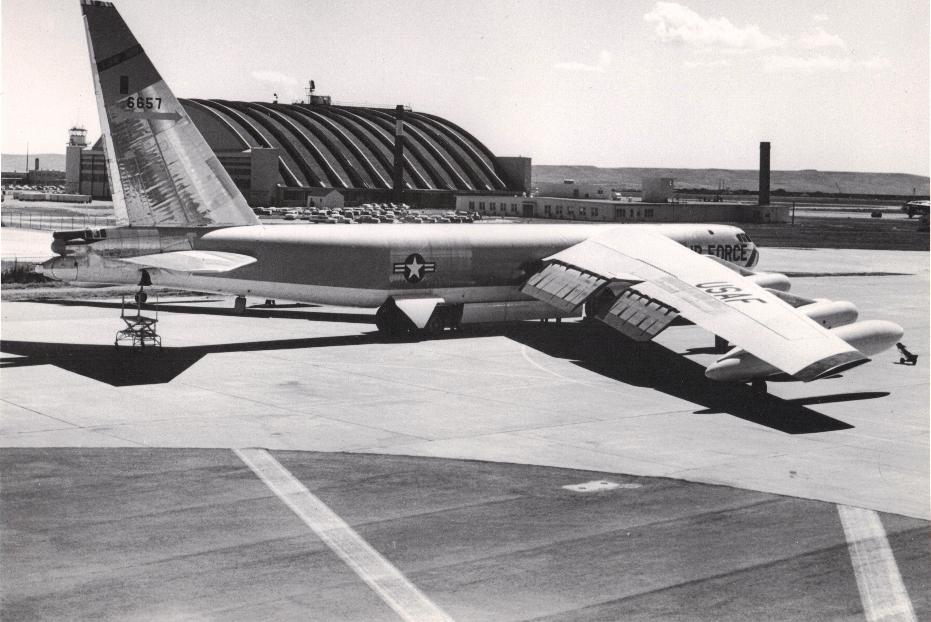
Ellsworth AFB

Slide 50
Rapid City Airport

Slide 51
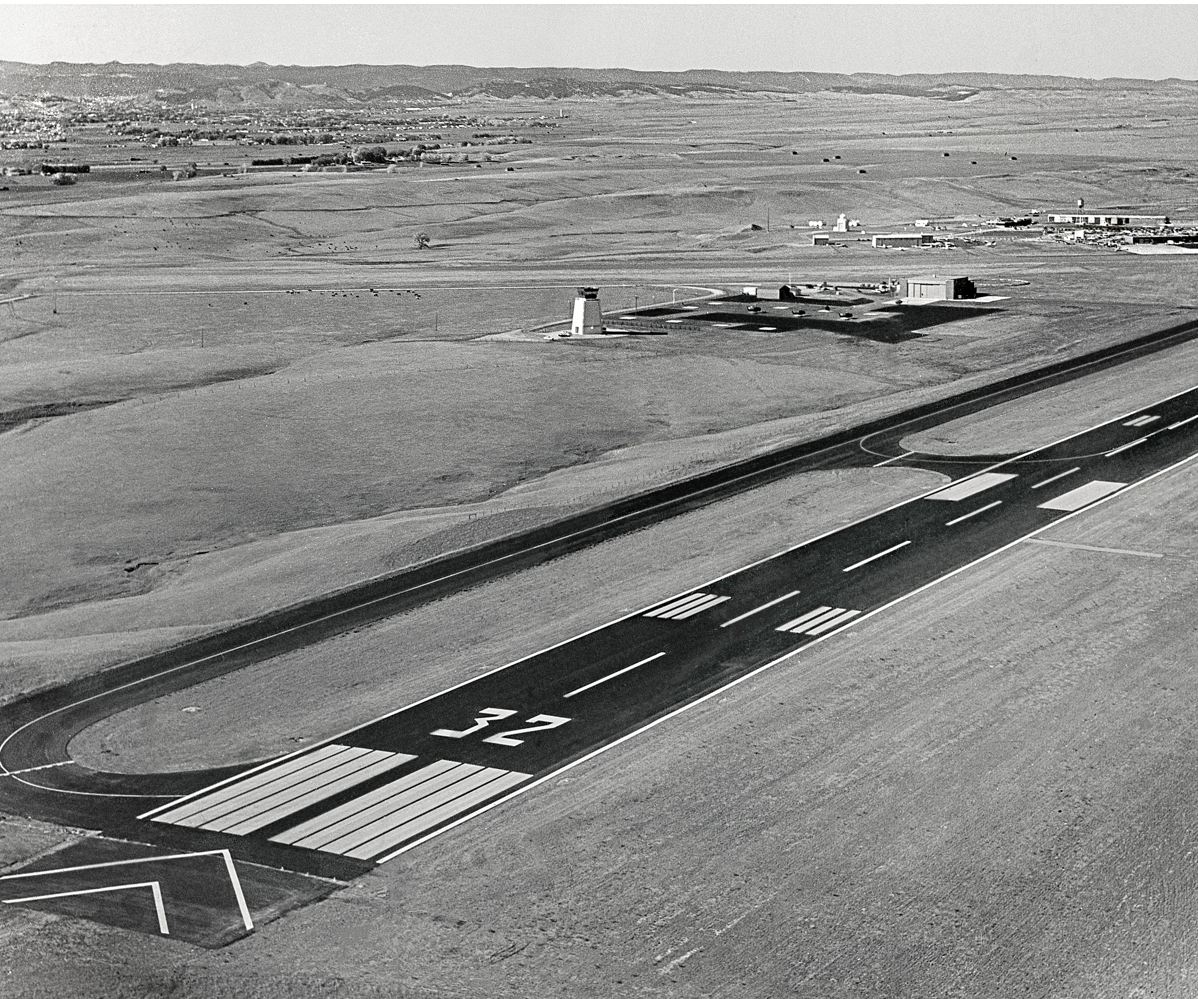

Slide 52
Sioux Falls Airport

Slide 53
Sioux Falls Terminal Groundbreaking

Slide 54
Convairs at Sioux Falls Terminal

Slide 57
Spearfish-Black Hills Air Fair 1939

Slide 58
Watertown Terminal

Slide 61
Yankton 1942

Slide 62
1943

Slide 63
Yankton College Trained Navy Aviation Cadets 1939-1945

Slide 69
Barrel Hangar

Slide 70
Tile Hangar

Slide 71
References
Sky Trails – Clyde Ice
History of Aviation in South Dakota - Robert Orr
South Dakota’s First Century of Flight, Norma Kraemer
History of Aviation in SD - Steven Bucklin
SD Aviation History, James Anez

